Slide 1
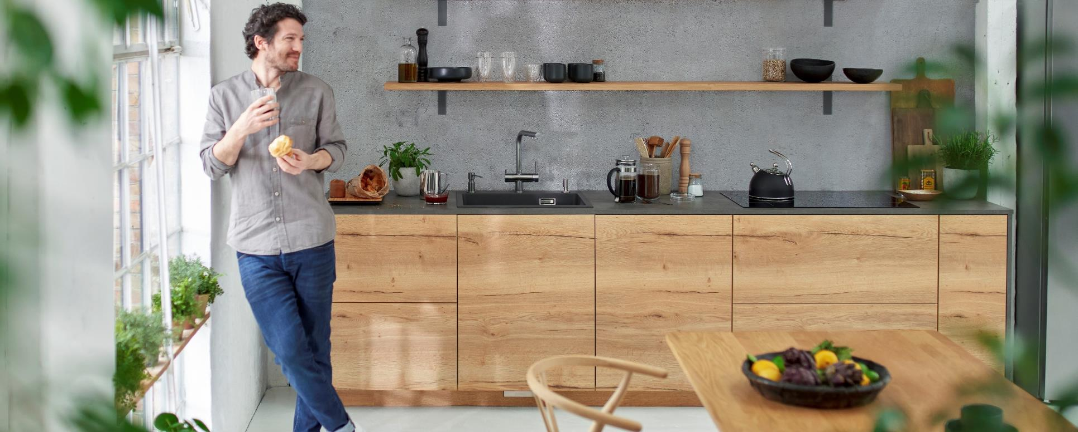
BLANCO FWD
Novelty presentation
[Insert Confidentiality Degree here if applicable]
Date | Author | Distribution List | File source

Slide 2
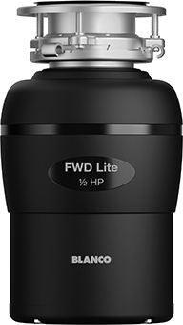
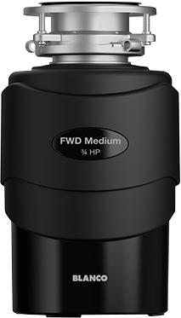
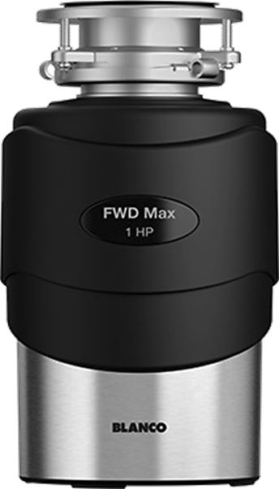
BLANCO FWD
Easy. Convenient. Clean.
Lite
Medium
Max

Slide 3
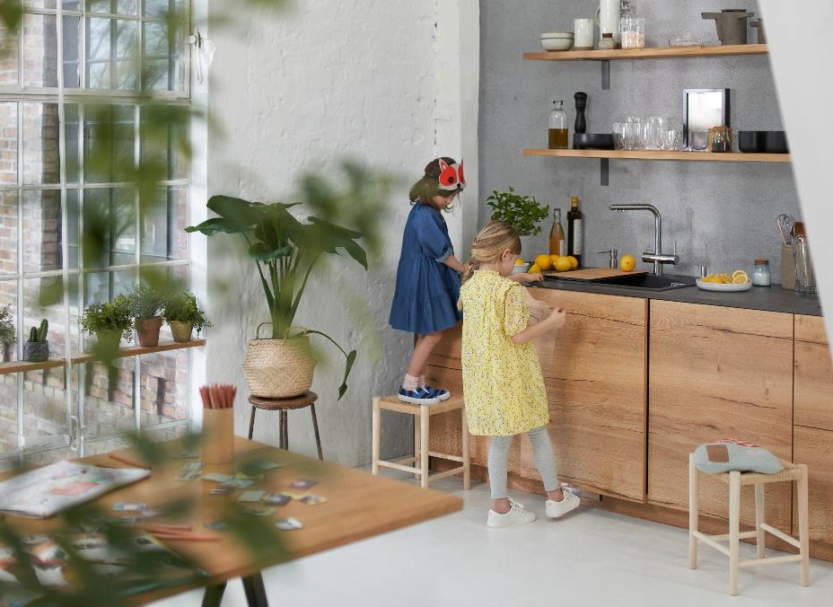
Agenda
1
Product features & specifications
2
Scope of supply
3
Focus on the BLANCO UNIT
4
Availability & Countries
5
Competitor Comparison
6
FAQ

Slide 4
Reason why
Strategic background of the launch of the BLANCO FWD
Gain new
market share
Enter a new
market category
Be a competitive
solution provider for
kitchen cabinet
waste systems
Fulfilling holistic
UNIT approach

Slide 5
BLANCO FWD
Common features at one glance
Common features of all models
Optimal interface management for BLANCO sinks and bowls
High quality and powerful AC induction motor
Dishwasher connection
Automatic shutdown function
Easy to install thanks to 3 bolt installation system
Grinding components made of stainless steel
Overload protection
Plug pre-installed ​(type of plug differs for each region)
Continuous feed

Slide 6
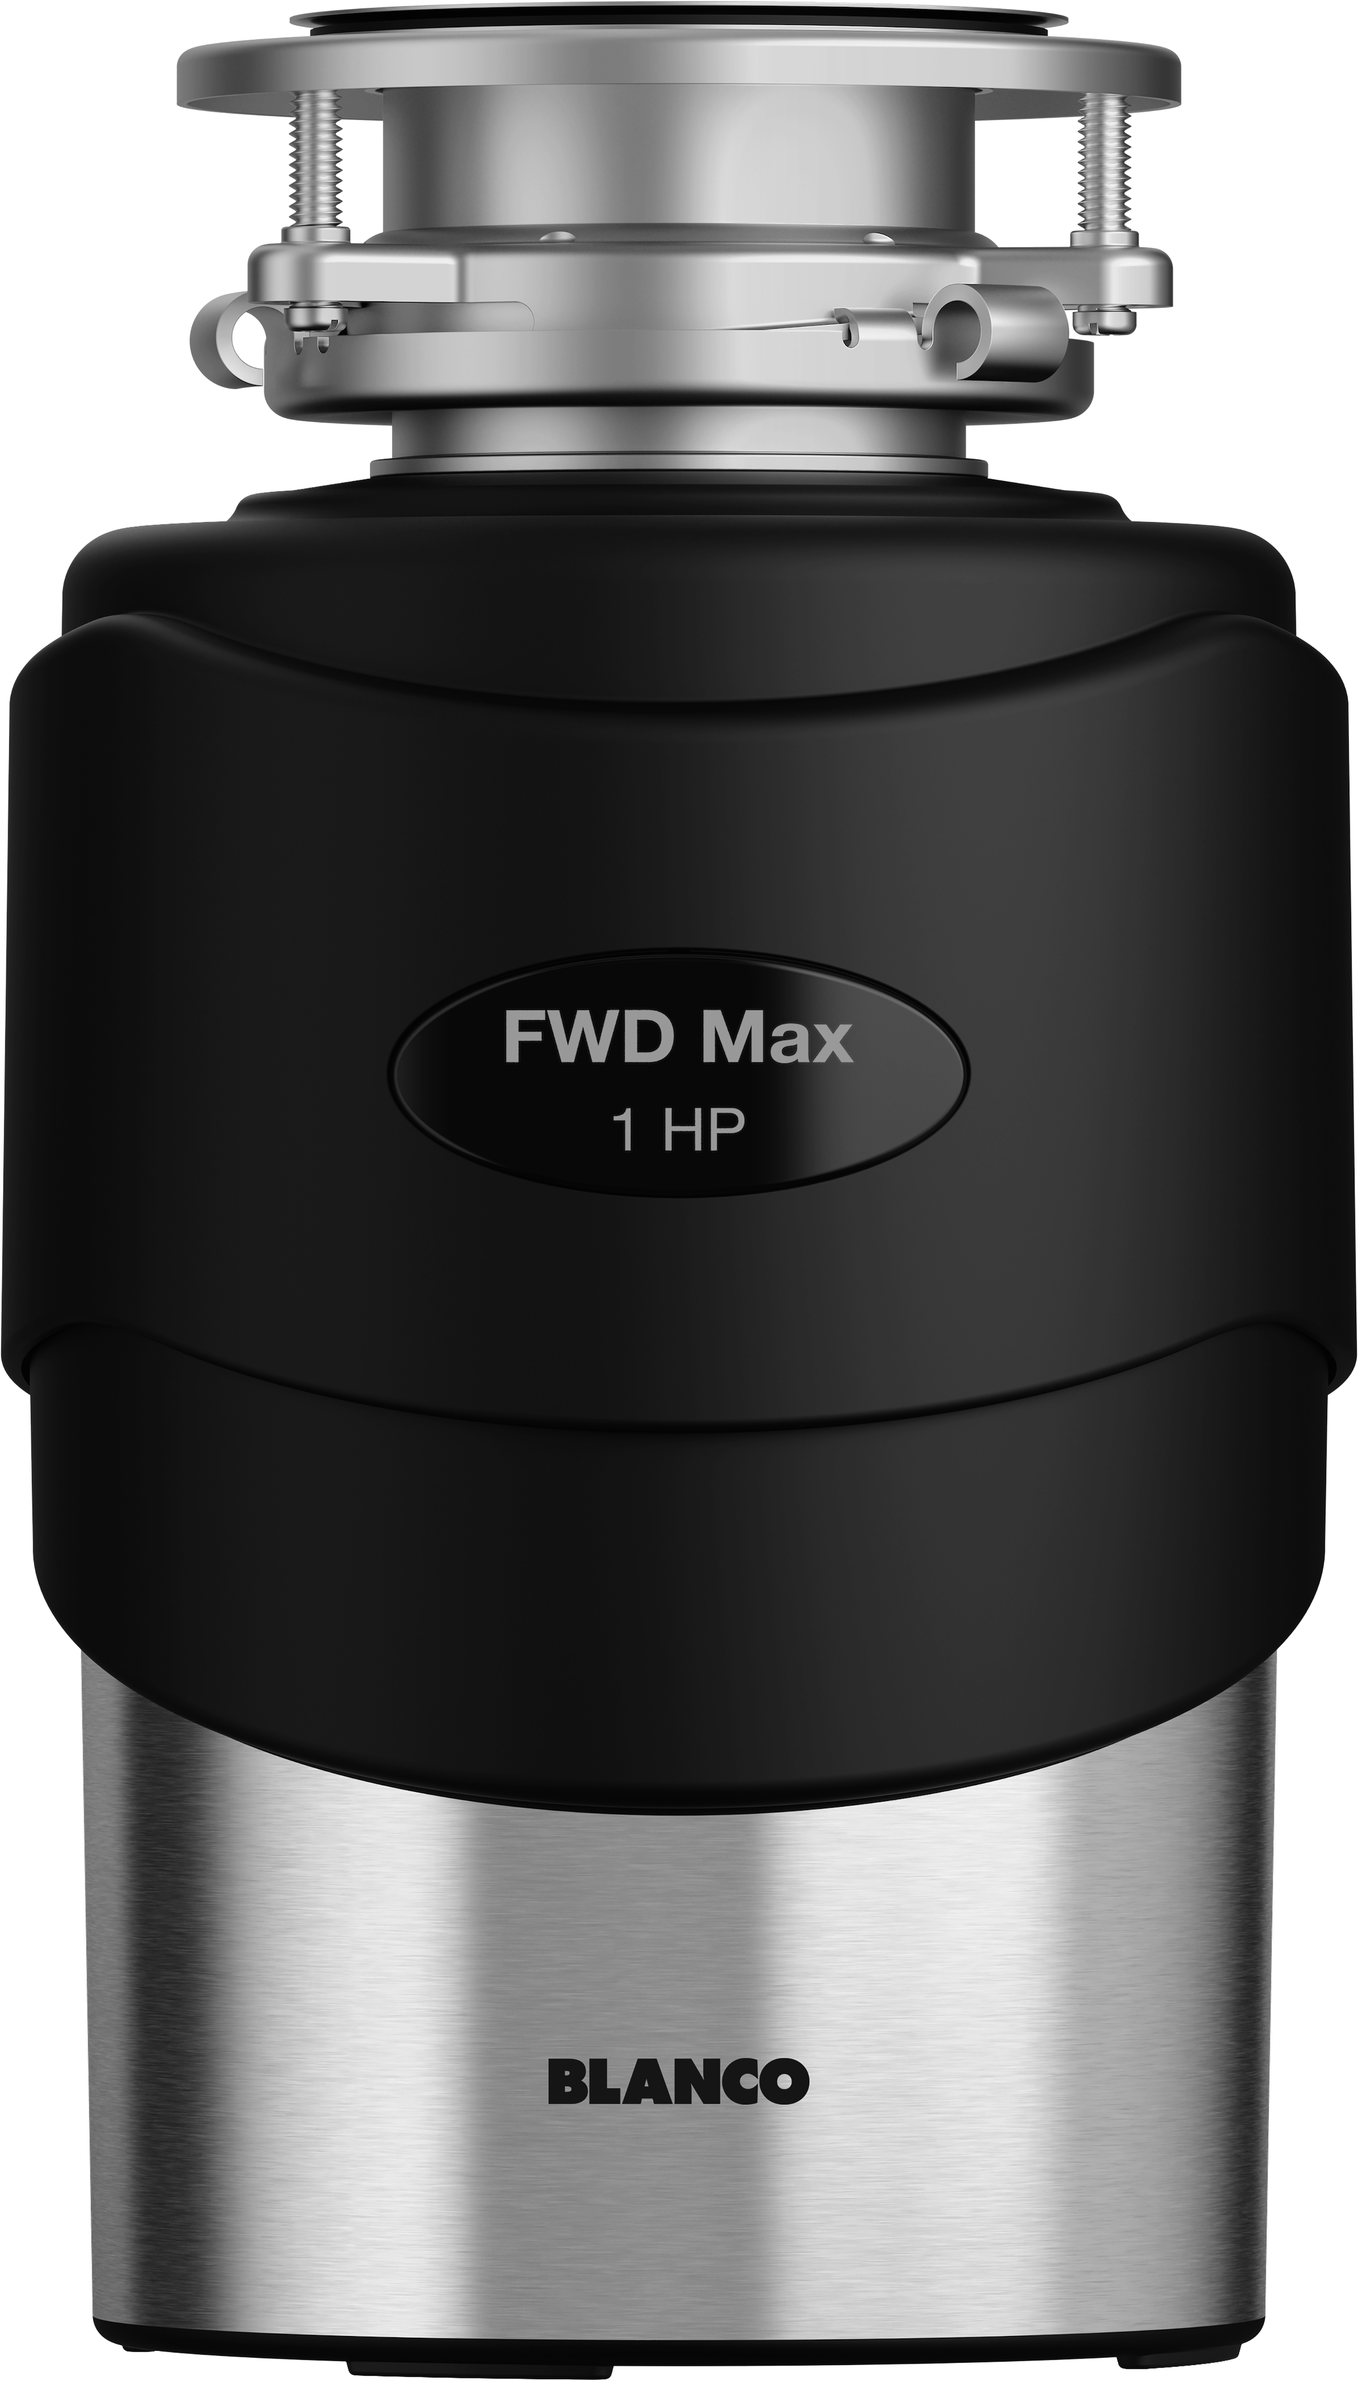
BLANCO FWD – Product range
What additional features does the next model have?
Premium model
  For regular disposing of large amounts of food waste
  1 HP
  Autoreverse function
  Very quiet
  High-quality design in matt black and brushed aluminum look
Advanced model
  For regular disposing of normal household amounts of food waste
  ¾ HP
  3 grinding stages for very fine grinding results
  Volume of grinding chamber 1200 ml
  Quiet
  Plug and strainer, air switch cap in PVD steel included
  Classic design in matt black with glossy elements
Entry-level model
  For disposing of small amounts of food waste
  ½ HP
  2 grinding stages for fine grinding results
  Volume of grinding chamber 900 ml
  Standard noise level
  Stopper, air switch cap in chrome included
  Simple design in matt black

Slide 7

BLANCO FWD in comparison
Product information – Plug type E+F
 | BLANCO FWD Lite​ | BLANCO FWD Medium​ | BLANCO FWD Max ​
Horse power​ | ½ HP​ | ¾ HP​ | 1 HP​
Power​ | 370 W​ | 550 W​ | 750 W​
Mains voltage | 230V/50Hz​ | 230V/50Hz​ | 230V/50Hz​
Number of grinding stage​ | 2​ | 3​ | 3​
Volume grinding chamber​ | 900 ml​ | 1200 ml​ | 1200 ml​
Automatic shutdown time​ | max. 25 min (when idle)​ | max. 25 min (when idle)​ | max. 10 min (when idle)​
Auto-reverse function​ | -​ | -​ | x​
Noise level​ | <70 dB​ | <60-70 dB​ | <60 dB​
Item No. | 526646 | 526647 | 526648

Slide 8


BLANCO FWD in comparison
Product information – Plug type G
 | BLANCO FWD Lite​ | BLANCO FWD Medium​ | BLANCO FWD Max ​
Horse power​ | ½ HP​ | ¾ HP​ | 1 HP​
Power​ | 370 W​ | 550 W​ | 750 W​
Mains voltage | 230V/50Hz​ | 230V/50Hz​ | 230V/50Hz​
Number of grinding stage​ | 2​ | 3​ | 3​
Volume grinding chamber​ | 900 ml​ | 1200 ml​ | 1200 ml​
Automatic shutdown time​ | max. 25 min (when idle)​ | max. 25 min (when idle)​ | max. 10 min (when idle)​
Auto-reverse function​ | -​ | -​ | x​
Noise level​ | <70 dB​ | <60-70 dB​ | <60 dB​
Item No. | 456438 | 456439 | 456440

Slide 9


BLANCO FWD in comparison
Product information – Plug type I
 | BLANCO FWD Lite​ | BLANCO FWD Medium​ | BLANCO FWD Max ​
Horse power​ | ½ HP​ | ¾ HP​ | 1 HP​
Power​ | 370 W​ | 550 W​ | 750 W​
Mains voltage | 230V/50Hz​ | 230V/50Hz​ | 230V/50Hz​
Number of grinding stage​ | 2​ | 3​ | 3​
Volume grinding chamber​ | 900 ml​ | 1200 ml​ | 1200 ml​
Automatic shutdown time​ | max. 25 min (when idle)​ | max. 25 min (when idle)​ | max. 10 min (when idle)​
Auto-reverse function​ | -​ | -​ | x​
Noise level​ | <70 dB​ | <60-70 dB​ | <60 dB​
Item No. | 470065 | 470066 | 470067

Slide 10

BLANCO FWD in comparison
Product information – Plug type B
 | BLANCO FWD Lite​ | BLANCO FWD Medium​ | BLANCO FWD Max ​
Horse power​ | ½ HP​ | ¾ HP​ | 1 HP​
Power​ | 370 W​ | 550 W​ | 750 W​
Mains voltage NA products​ | 120V/60Hz​ | 120V/60Hz​ | 120V/60Hz​
Number of grinding stage​ | 2​ | 3​ | 3​
Volume grinding chamber​ | 900 ml​ | 1200 ml​ | 1200 ml​
Automatic shutdown time​ | max. 25 min (when idle)​ | max. 25 min (when idle)​ | max. 10 min (when idle)​
Auto-reverse function​ | -​ | -​ | x​
Noise level​ | <70 dB​ | <60-70 dB​ | <60 dB​
Item No. | 442977 | 442978 | 442979

Slide 11
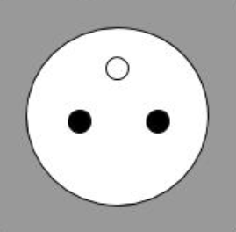
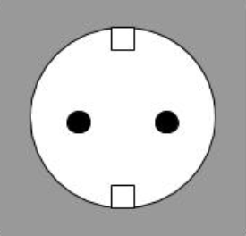



Product range
Region | Segment | Item no. | Mains Voltage | Plug
EMEA | FWD Lite | 526646 | 230V / 50Hz | Type E+F (CEE 7/7)
 | FWD Medium | 526647
 | FWD Max | 526648
UK, India | FWD Lite | 456438 | 230V / 50Hz | Type G (BS 1363)
 | FWD Medium | 456439
 | FWD Max | 456440
AUS, NZL, CN | FWD Lite | 470065 | 230V / 50Hz | Type I (AS 3112)
 | FWD Medium | 470066
 | FWD Max | 470067
North America | FWD Lite | 442977 | 120V / 60Hz | Type B (NEMA-5)
 | FWD Medium | 442978
 | FWD Max | 442979

Slide 12


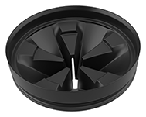
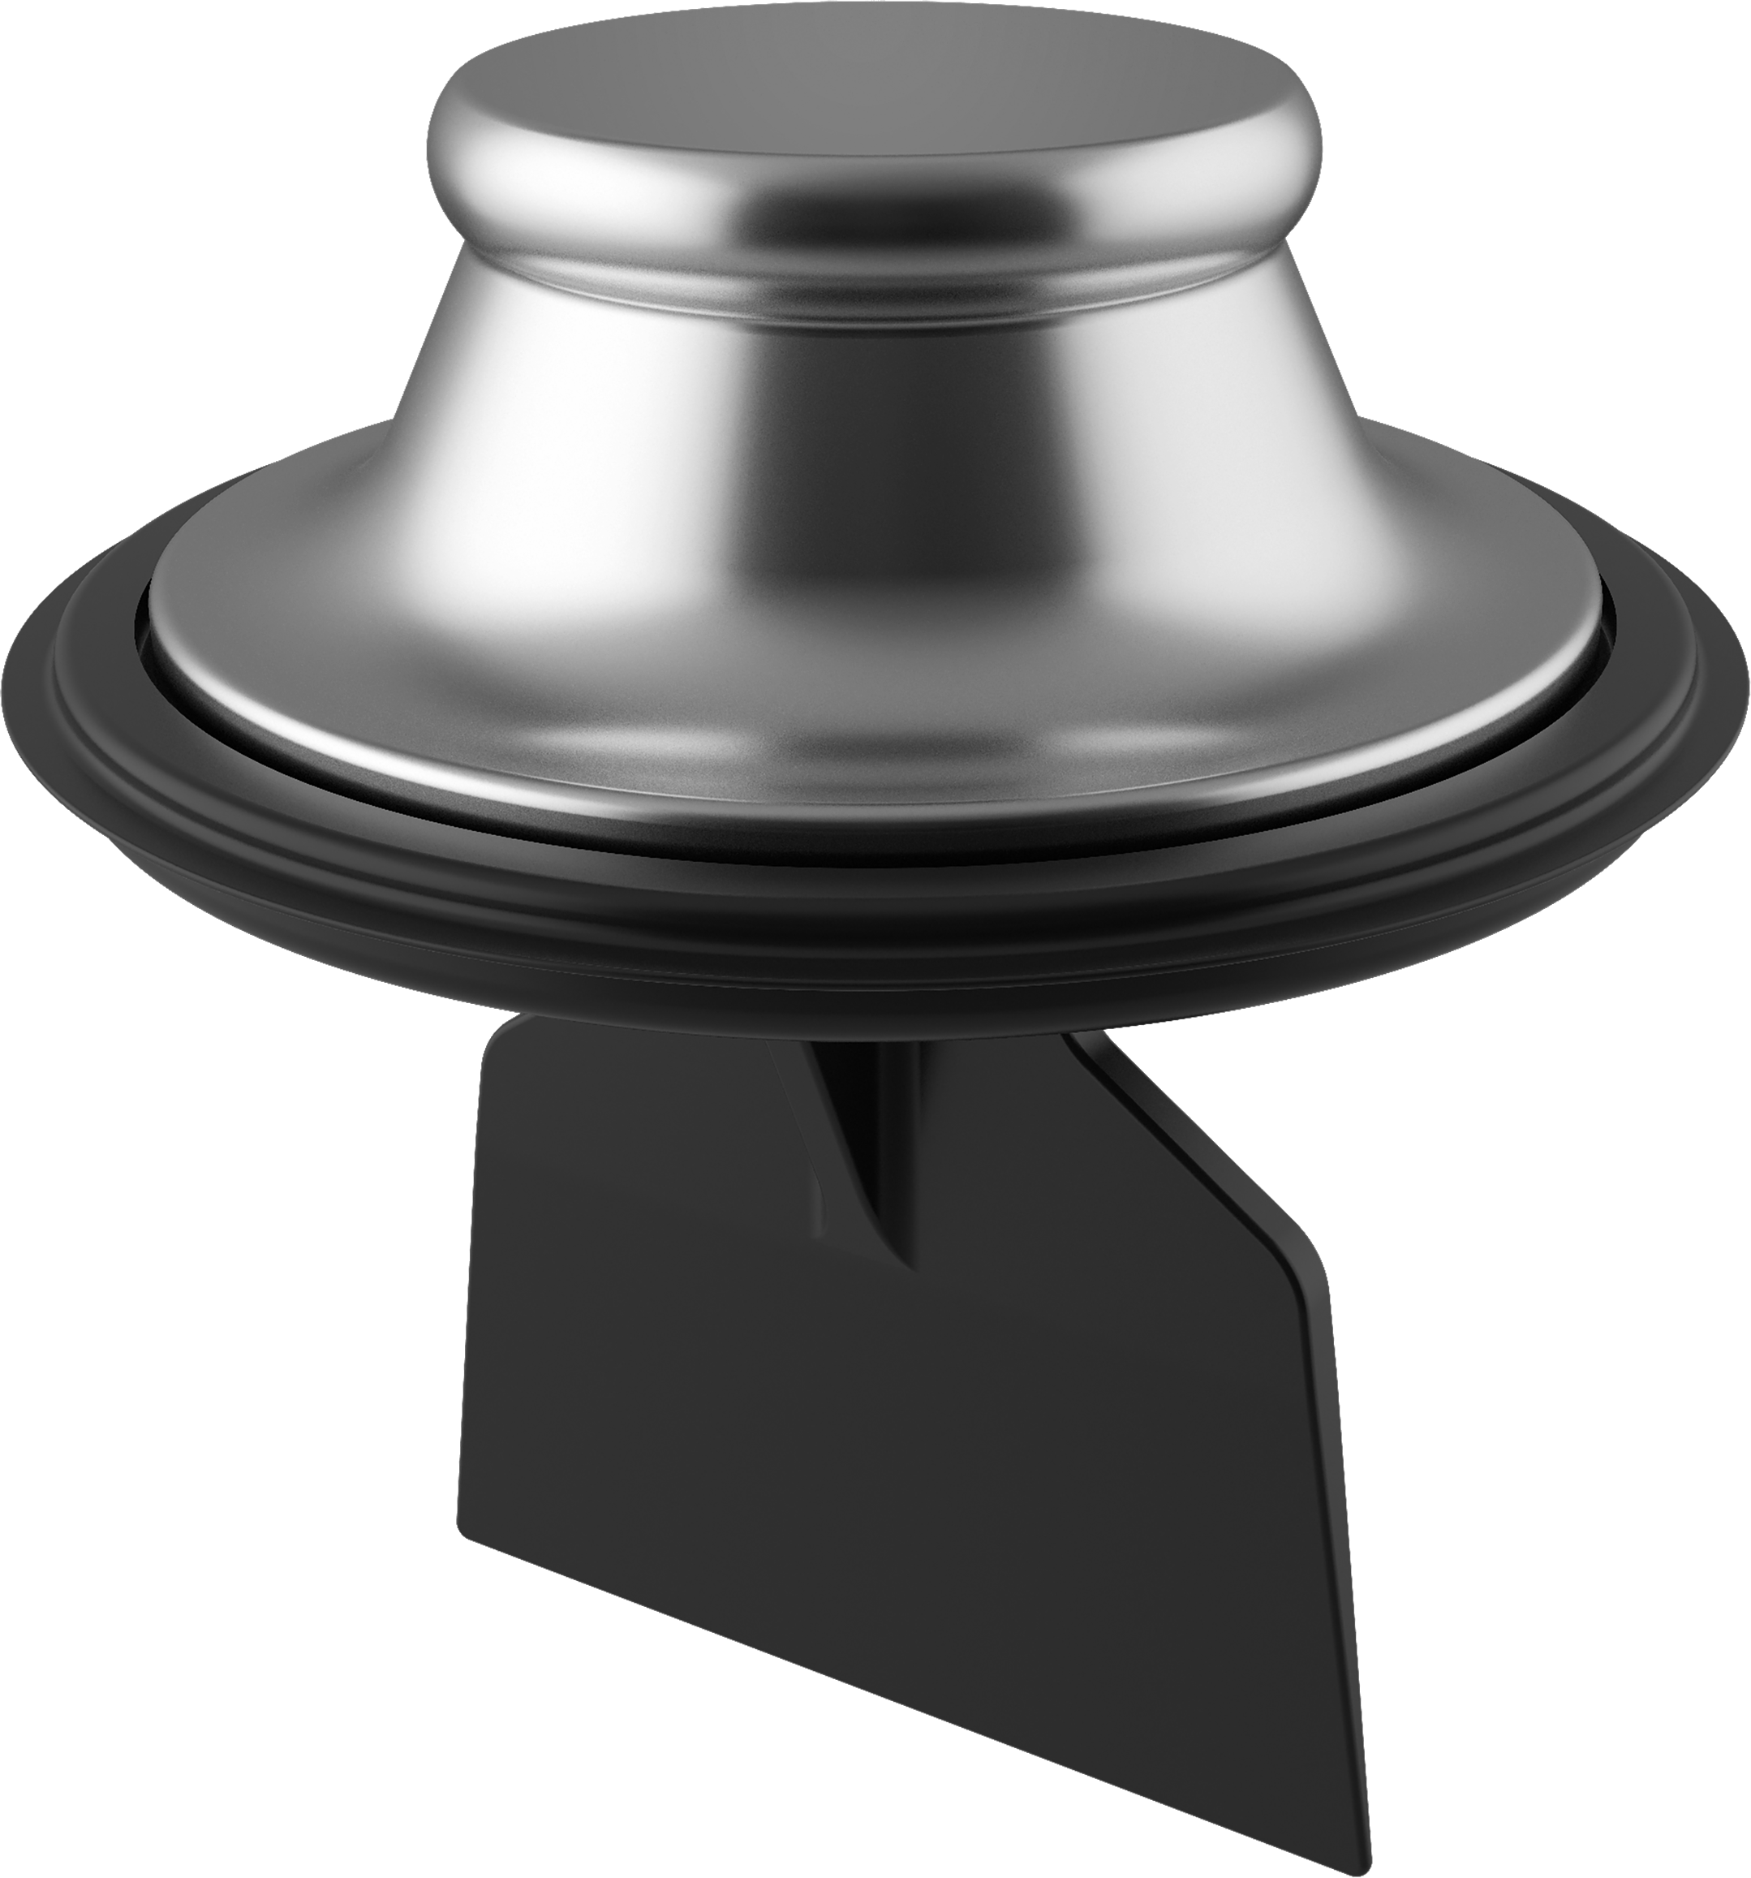
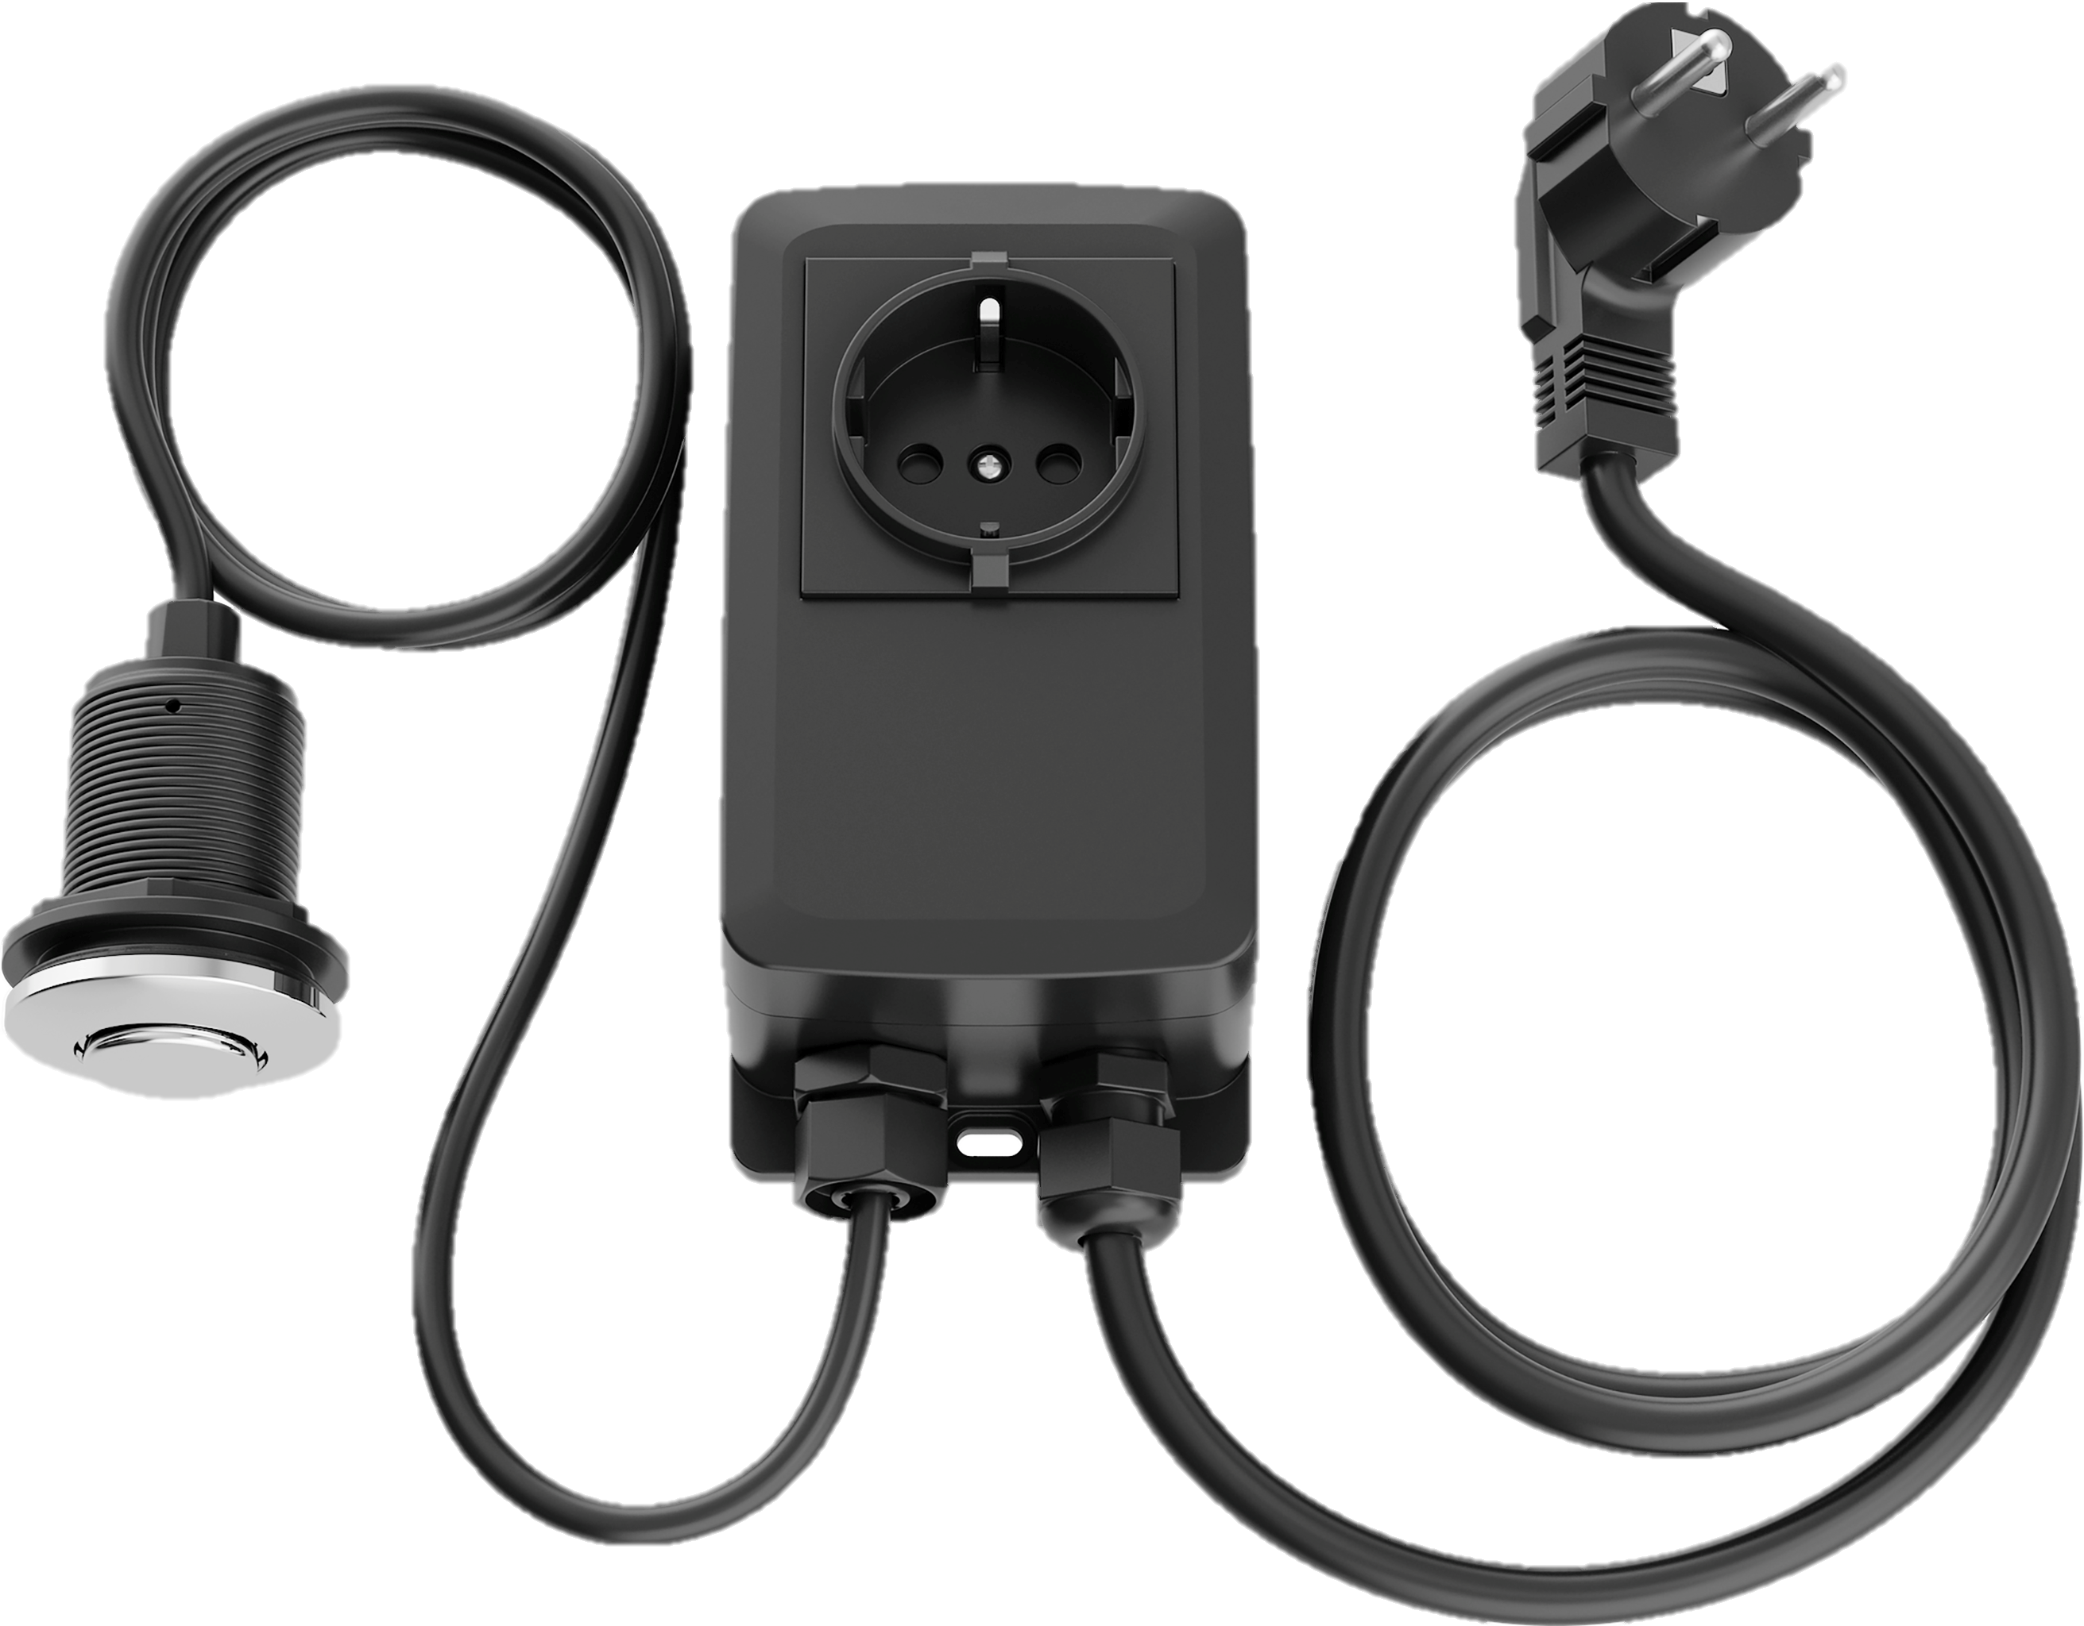
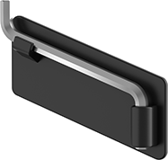
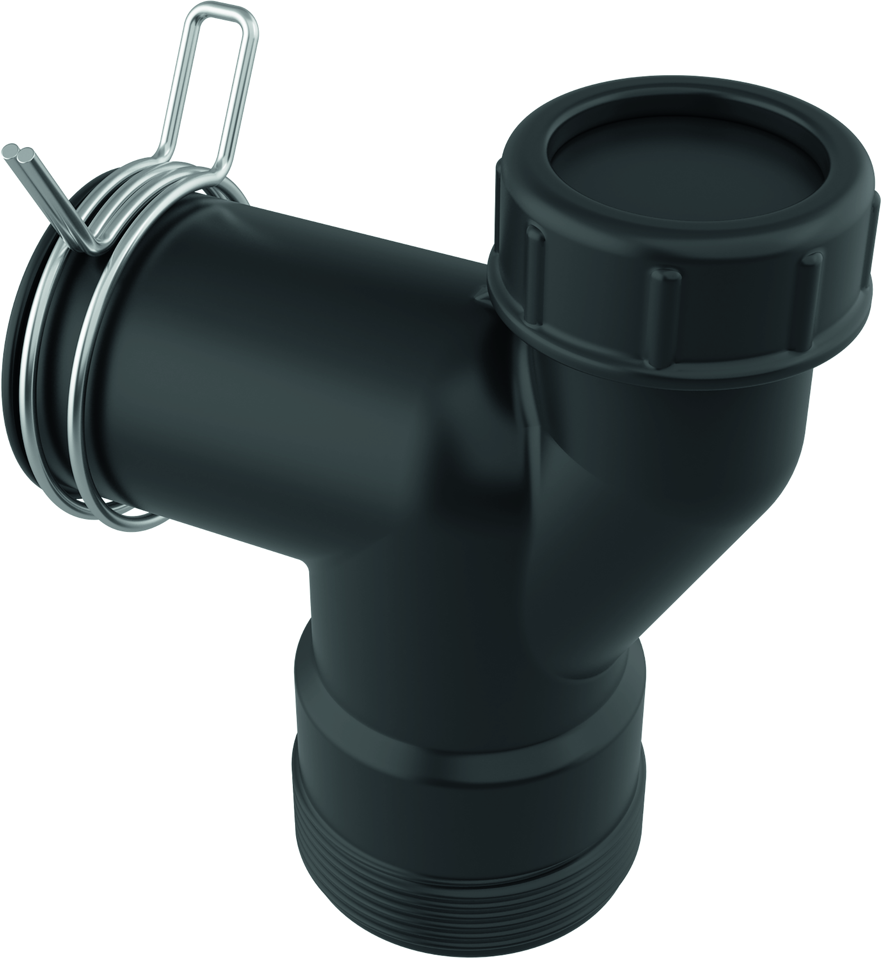
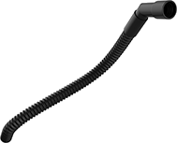
Scope of supply
Plug type E+F, G, I
BLANCO FWD
Lite
Removable baffle
Stopper to close drain
Air switch set including cap in chrome
Including pre-installed plug
Item No. 456438, 526646, 470065
L-pipe-set with dishwasher or overflow connection
Overflow connection for all BLANCO sinks
Wrench for mounting and free blockage

Slide 13
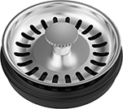
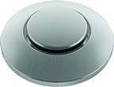
Scope of supply
Plug type E+F, G, I
BLANCO FWD Medium
Removable baffle
Plug and strainer to close drain
Air switch set including cap in chrome and PVD steel
Including pre-installed plug
Item No. 456439, 526647, 470066
L-pipe-set with dishwasher or overflow connection
Overflow connection for all BLANCO sinks
Wrench for mounting and free blockage

Slide 14
Scope of supply
Plug type E+F, G, I
BLANCO FWD
Max
Removable baffle
Plug and strainer to close drain
Air switch set including cap in chrome and PVD steel
Including pre-installed plug
Item No. 456440, 526648, 470067
L-pipe-set with dishwasher or overflow connection
Overflow connection for all BLANCO sinks
Wrench for mounting and free blockage

Slide 15
Scope of supply
Plug type B
BLANCO FWD
Lite
Removable baffle
Stopper to close drain
L-pipe-set with dishwasher or overflow connection
Including pre-installed plug
Item No. 442977
Wrench for mounting and free blockage

Slide 16
Scope of supply
Plug type B
BLANCO FWD Medium
Removable baffle
Plug and strainer to close drain
L-pipe-set with dishwasher or overflow connection
Including pre-installed plug
Item No. 442978
Wrench for mounting and free blockage

Slide 17
Scope of supply
Plug type B
BLANCO FWD
Max
Removable baffle
Plug and strainer to close drain
L-pipe-set with dishwasher or overflow connection
Including pre-installed plug
Item No. 442979
Wrench for mounting and free blockage

Slide 18
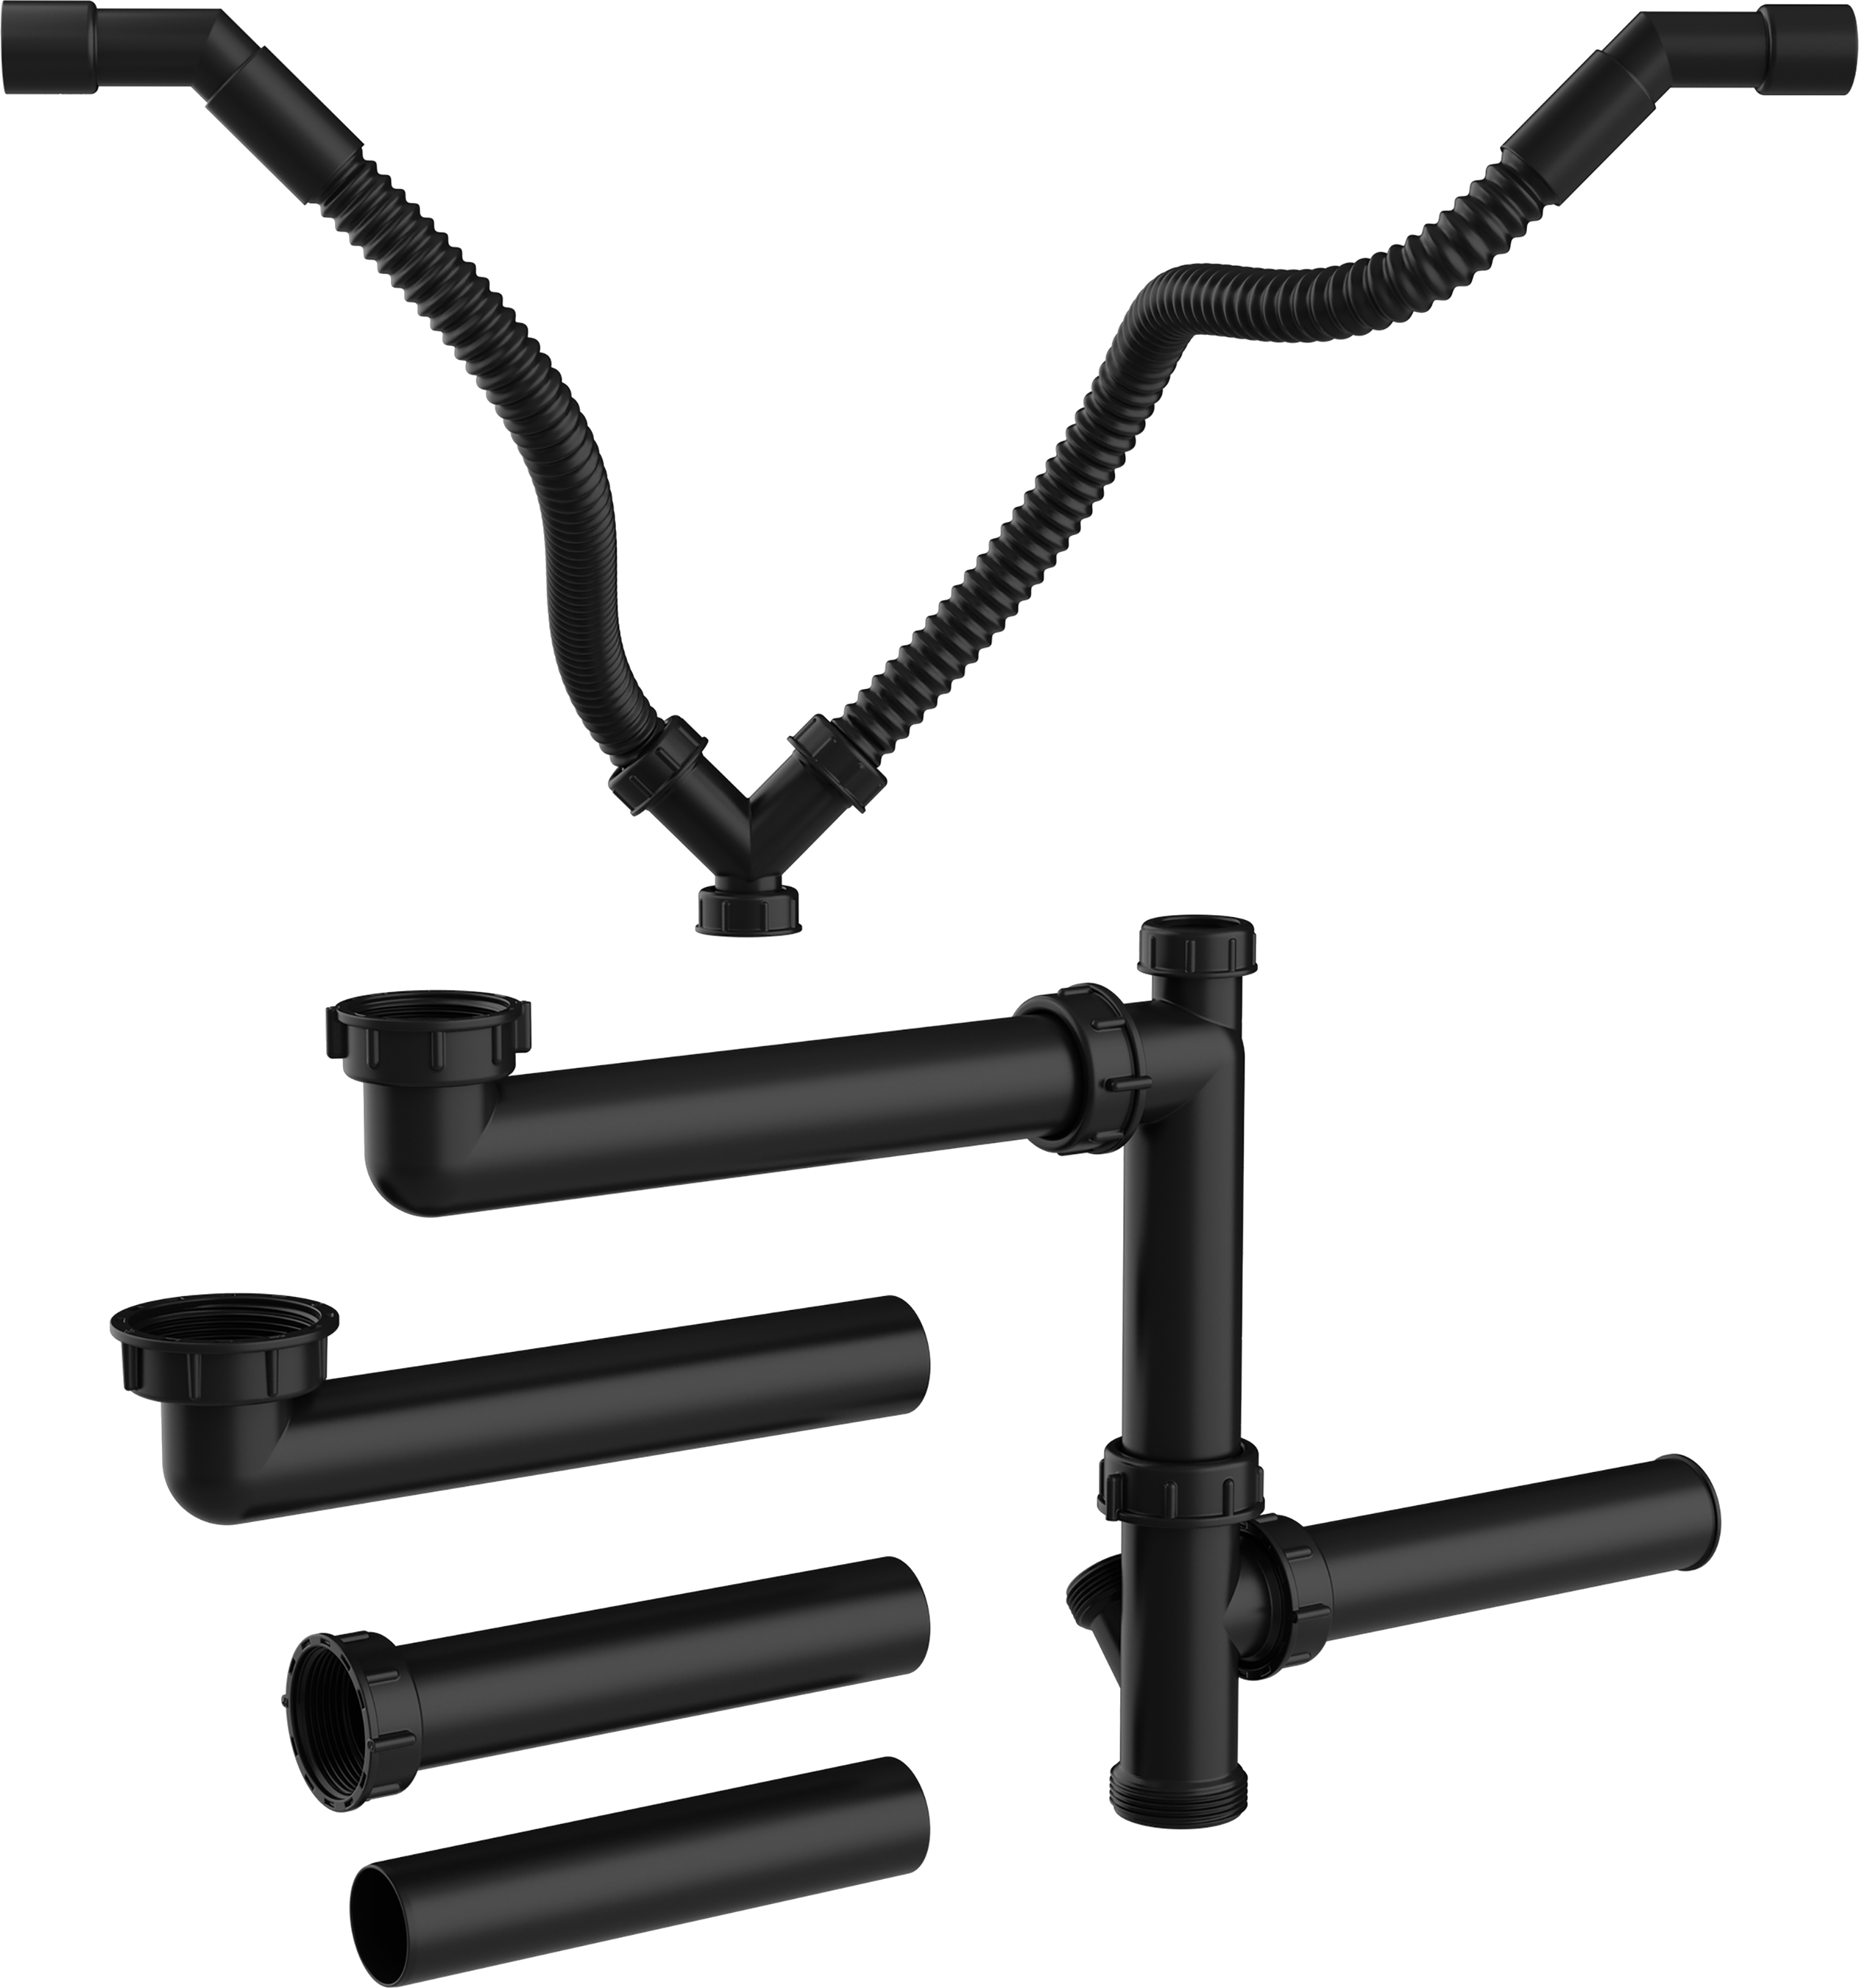
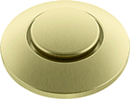
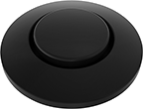
Accessories (optional)
2nd bowl piping set
Air switch cap
PVD steel
Item No. 526768
Satin gold
Item No. 526769
Matt black
Item No. 526770
Item No. 526772

Slide 19
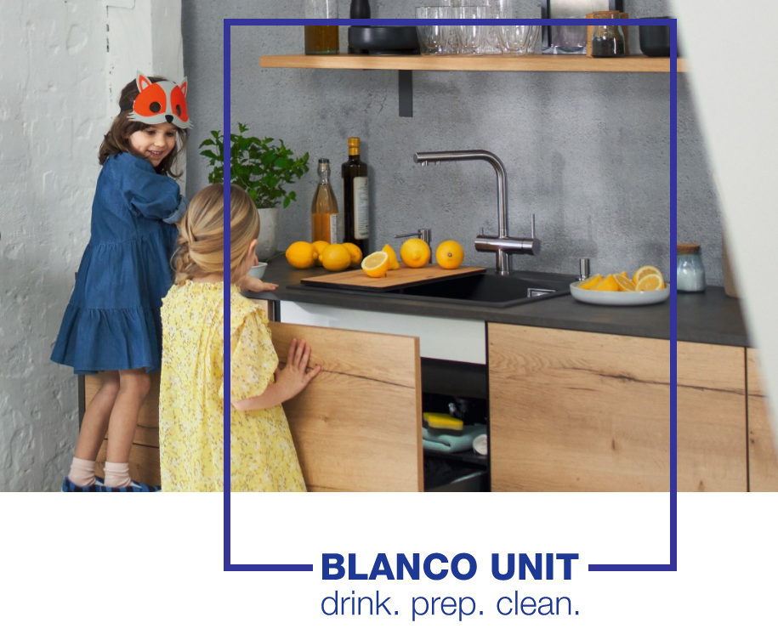
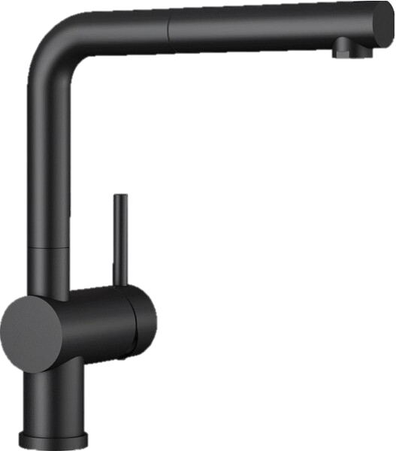
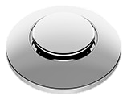
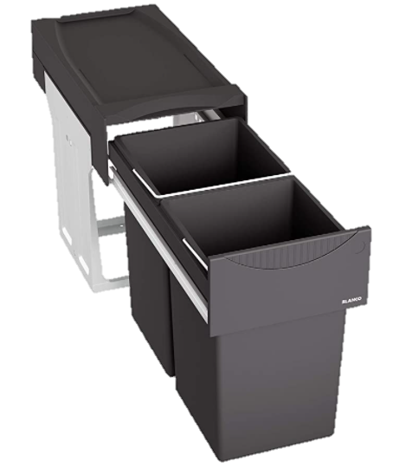
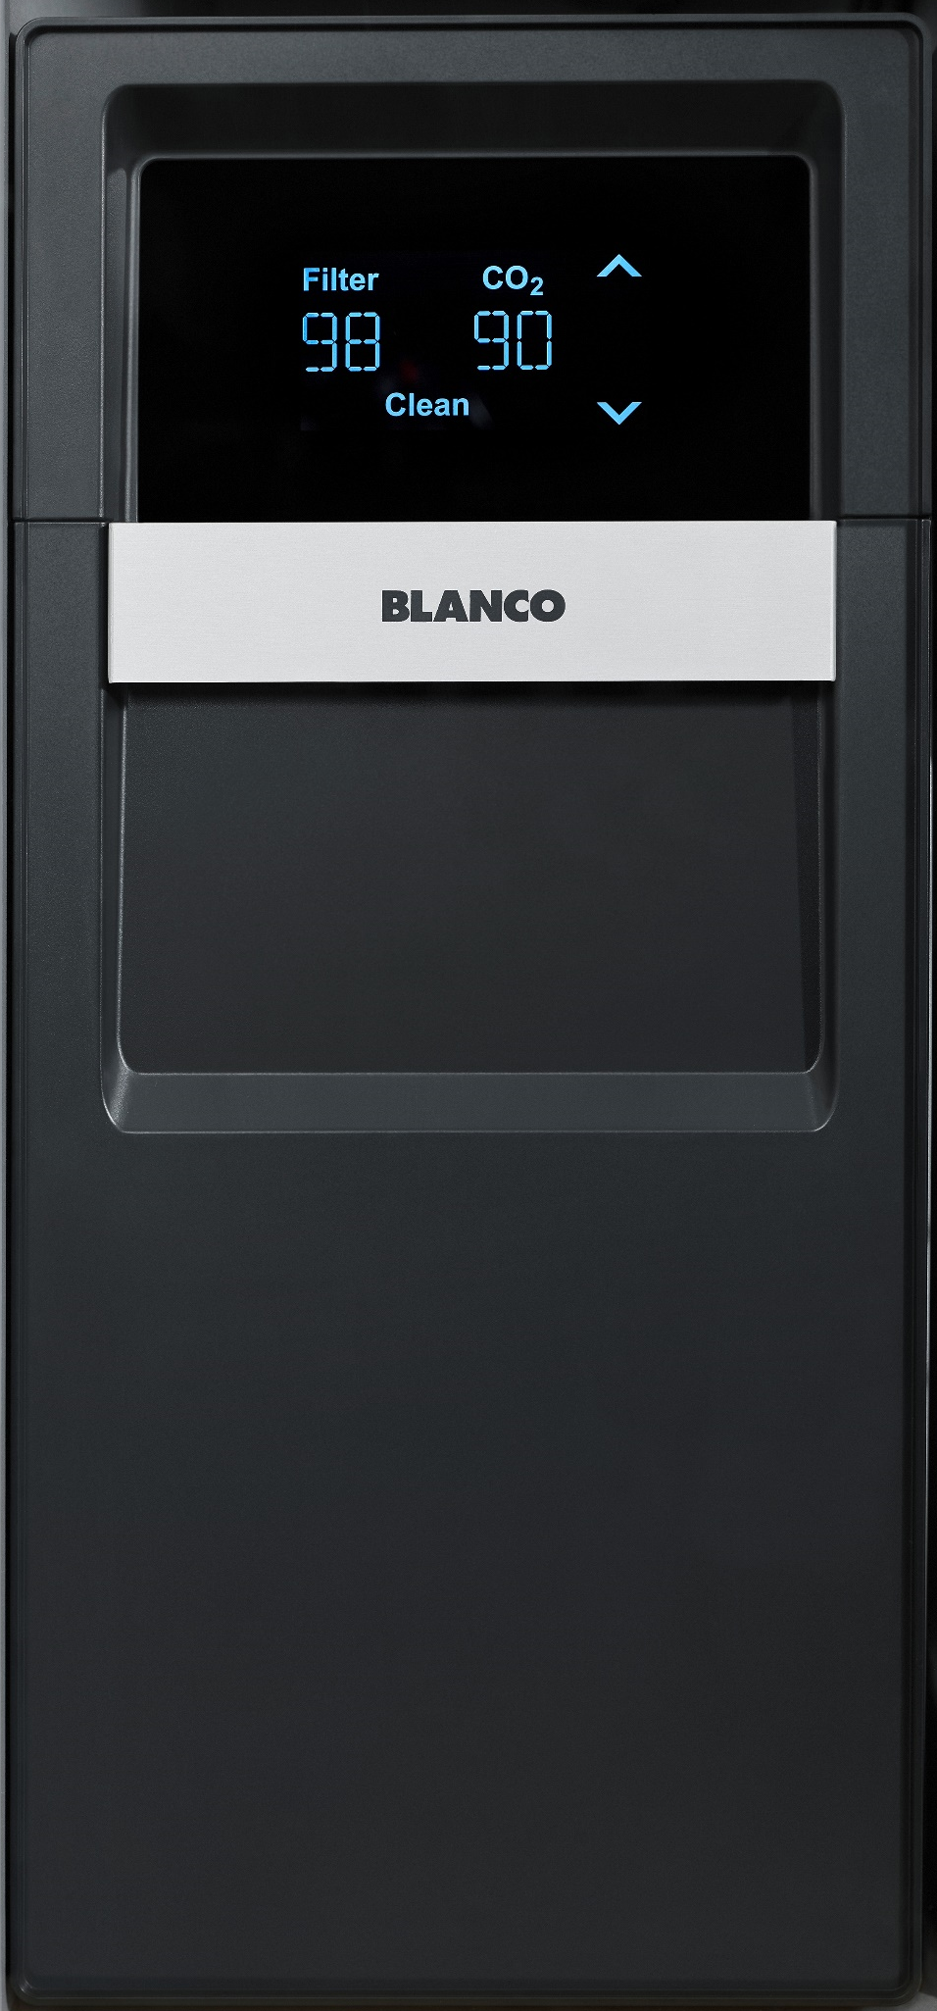
Marketing focus is on the UNIT
What exactly does the UNIT support in the disposer portfolio?
No worries
Disposers are for sure matching to BLANCO sinks as BLANCO is an expert for sinks, e.g. L-pipe, diameter,
2nd bowl piping set
Same Colours
Air switch as visible part available
in most important BLANCO
faucet colours
One Look
Meeting the design of other
BLANCO products under the sink
for a premium and uniform look
More arguments to come!

Slide 20
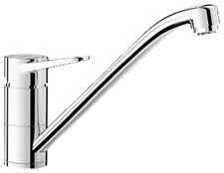
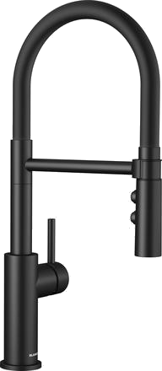
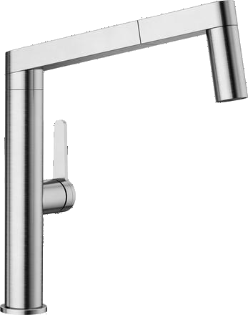
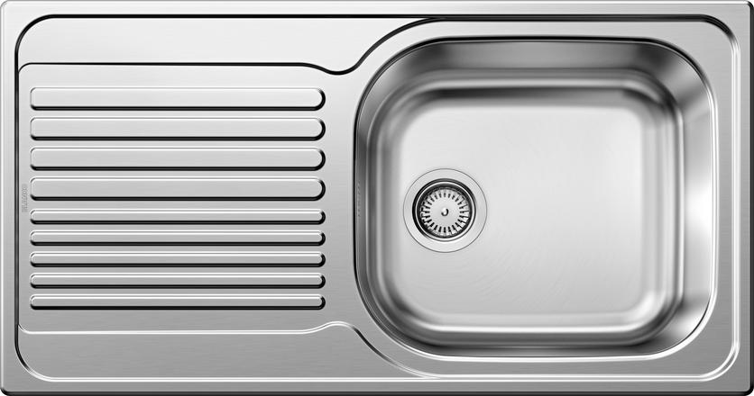
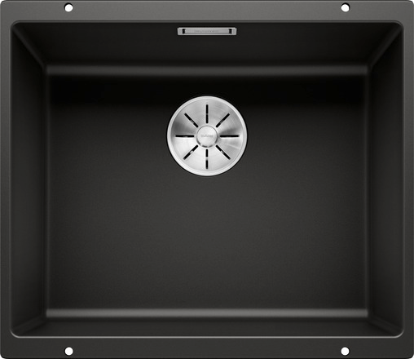
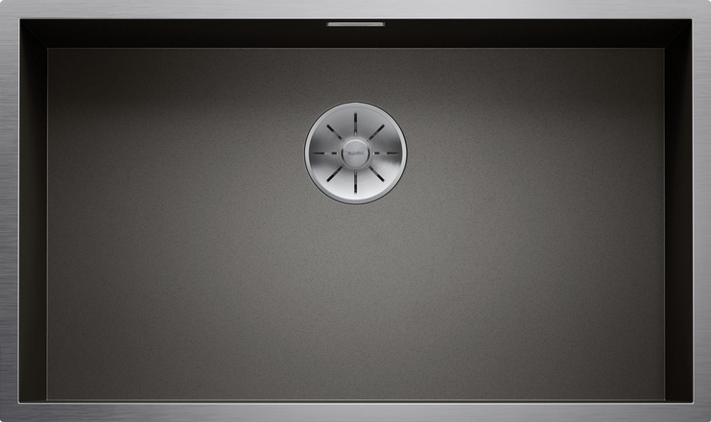
In Harmony with Sink and Mixer Tap​
UNIT possibilities based on selected Models*
Water
BLANCOWEGA II
CATRIS-S Flexo
PANERA-S
Sink
TIPO XL 6 S
SUBLINE 500-U
ZEROX 700-U
Waste
FWD Lite
FWD Medium
FWD Max
*This overview does not replace a dimensional check.

Slide 21
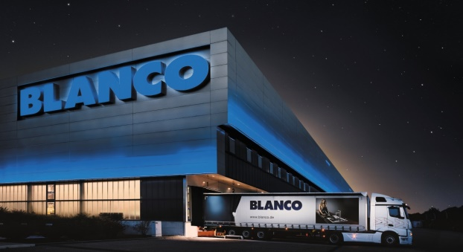
Positioning and Availability
  Positioning
  Availability
  → Plug type E+F, G, I, B
  Models
  BLANCO FWD Lite
  Item No. 526646, 456438, 442977, 470065
  BLANCO FWD Medium
  Item No. 526647, 456439, 442978,
  470066
  BLANCO FWD Max
  Item No. 526648, 456440, 442979, 470067
Best
Available for Order
REMEA, APAC | from CW 16/2022
CN | from CW 4/2022
BLANCO FWD Max
Better
BLANCO FWD Medium
Good
BLANCO FWD Lite

Slide 22
Availability of FWD in 2022
Launch in 2022
UK
Spain
France
Slovakia/Czech
Poland
Denmark
Italy
Hungary
Israel
Russia
China
India
Australia / New Zealand
North America
Launch tbd
Warehouse availability
REMEA, APAC from CW 16/2022
CN from CW 4/2022

Slide 23
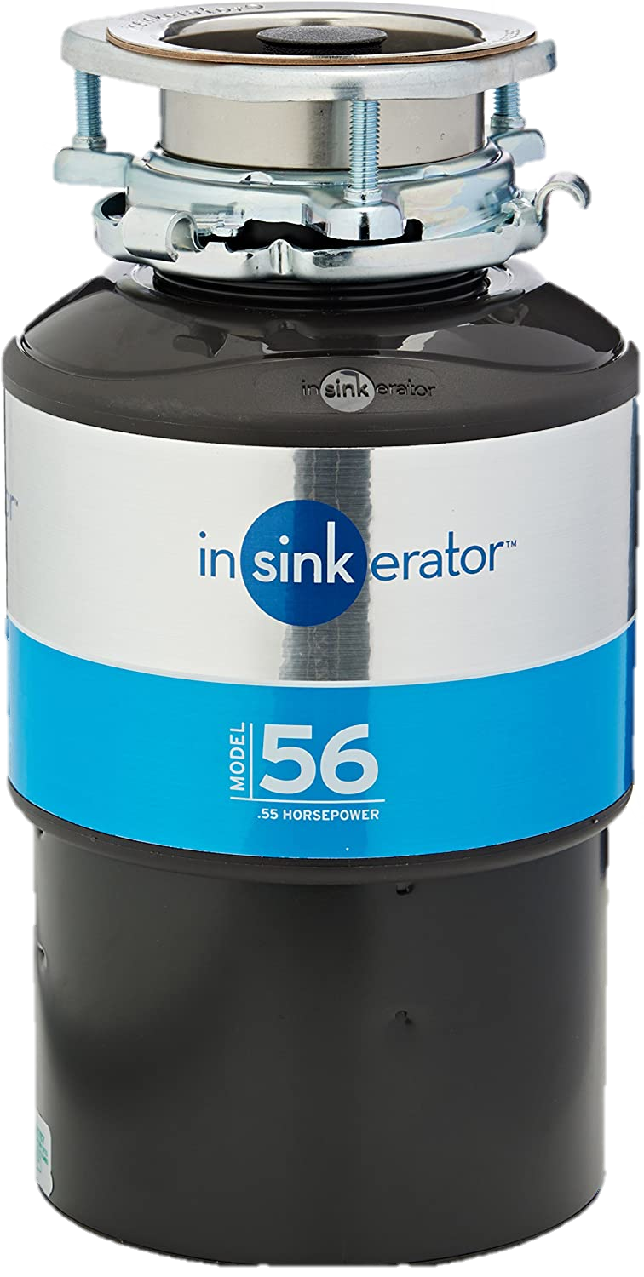
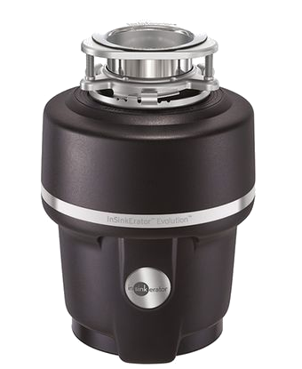
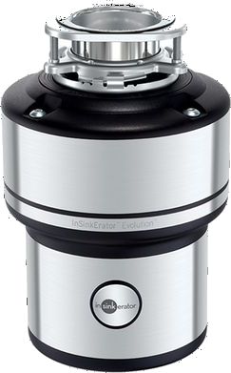
Competitor Comparison – InSinkErator
 | BLANCO FWD Lite​ | Model 56 | BLANCO FWD Medium​ | Evolution 150 | BLANCO FWD Max ​ | Evolution 250
Horse power​ | 0,5 HP​ | 0,55 HP | 0,75 HP​ | 0,75 HP | 1 HP​ | 0,75 HP
Power​ | 370 W​ | 380 W | 550 W​ | 380 W | 750 W​ | 380 W
Motor​ | AC induction motor​ | AC induction motor​ | AC induction motor​ | AC induction motor​ | AC induction motor​ | AC induction motor​
Mains voltage NA products​ | 120V/60Hz​ | 120V/60Hz​ | 120V/60Hz​ | 120V/60Hz​ | 120V/60Hz​ | 120V/60Hz​
Mains voltage all other products​ | 230V/50Hz​ | 220V-240V/50Hz-60Hz | 230V/50Hz​ | 220-240V/50-60Hz | 230V/50Hz​ | 220-240V/50Hz
plug pre-installed ​ | x​ | x | x​ | x | x​ | x
3 bolt installation​ | x​ | x | x​ | x | x​ | x
Material grinding components​ | stainless steel​ | stainless steel | stainless steel​ | stainless steel​ | stainless steel​ | stainless steel​
Number of grinding stage​ | 2​ | 1 | 3​ | 2 | 3​ | 3
Volume grinding chamber​ | 900 ml​ | 980 ml | 1200 ml​ | 1005 ml | 1200 ml​ | 1180 ml
Automatic shutdown function​ | x​ | x | x​ | x | x​ | x
Automatic shutdown time​ | max. 25 min (when idle)​ | no information | max. 25 min (when idle)​ | no information | max. 10 min (when idle)​ | no information
Auto-reverse function​ | -​ | - | -​ | x | x​ | x
Feeding type​ | continuous​ | continuous​ | continuous​ | continuous​ | continuous​ | continuous​
Noise level​ | standard (<70 dB) | Quiet sound reduction technology | quiet (<60-70 dB​) | Evolution-Quiet technology (one of their quietest disposals) | very quiet (<60 dB​) | Evolution-Quiet technology (the quietest disposal in their range)
Dishwasher connection/ connectable​ | x​ | x | x​ | x | x​ | x
Overload protection​ | x​ | x | x​ | x | x​ | x
Size (H x W) [mm] | 320 x 180 | 308 x 194 | 335 x 203 | 311 x 222 | 335 x 203 | 330 x 234
Notes:
Unterschiede kennzeichnen

Slide 24
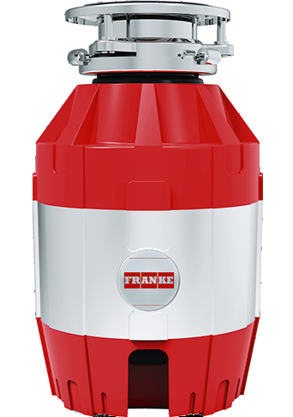
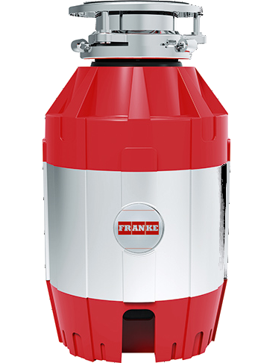
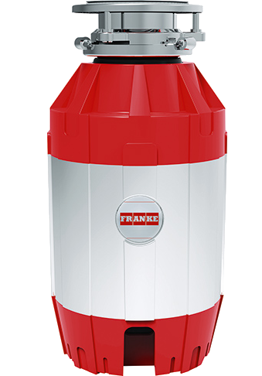
Competitor Comparison – Franke
 | BLANCO FWD Lite​ | Franke TE-50 | BLANCO FWD Medium​ | Franke TE-75 | BLANCO FWD Max ​ | Franke TE-125
Horse power​ | 0,5 HP​ | 0,5 HP | 0,75 HP​ | 0,75 HP | 1 HP​ | 1,25 HP
Power​ | 370 W​ | 375 W | 550 W​ | 550 W | 750 W​ | 930 W
Motor​ | AC induction motor​ | DC motor | AC induction motor​ | DC motor | AC induction motor​ | DC motor
Mains voltage NA products​ | 120V/60Hz​ | no information | 120V/60Hz​ | no information | 120V/60Hz​ | no information
Mains voltage all other products​ | 230V/50Hz​ | 220-240V/50-60Hz | 230V/50Hz​ | 220-240V/50-60Hz | 230V/50Hz​ | 220-240V/50-60Hz
plug pre-installed ​ | x​ | x | x​ | x | x​ | x
3 bolt installation​ | x​ | x | x​ | x | x​ | x
Material grinding components​ | stainless steel​ | stainless steel​ | stainless steel​ | stainless steel​ | stainless steel​ | stainless steel​
Number of grinding stage​ | 2​ | 3 | 3​ | 3 | 3​ | 3
Volume grinding chamber​ | 900 ml​ | no information | 1200 ml​ | no information | 1200 ml​ | no information
Automatic shutdown function​ | x​ | reset button | x​ | reset button | x​ | reset button
Automatic shutdown time​ | max. 25 min (when idle)​ | - | max. 25 min (when idle)​ | - | max. 10 min (when idle)​ | -
Auto-reverse function​ | -​ | x | -​ | x | x​ | x
Feeding type​ | continuous​ | continuous | continuous​ | continuous | continuous​ | continuous
Noise level​ | standard (<70 dB) | 40-45 dB | quiet (<60-70 dB​) | 40-45 dB | very quiet (<60 dB​) | 40-45 dB
Dishwasher connection/ connectable​ | x​ | x | x​ | x | x​ | x
Overload protection​ | x​ | no information | x​ | no information | x​ | no information
Size (H x W) [mm] | 320 x 180 | 345 x 200 | 335 x 203 | 371 x 200 | 335 x 203 | 406 x 200

Slide 25
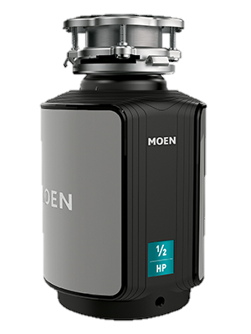
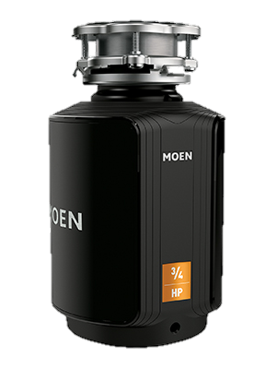
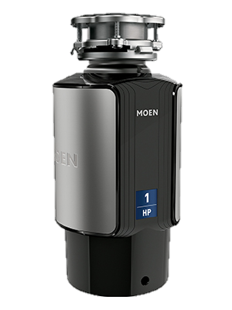
Competitor Comparison – Moen
 | BLANCO FWD Lite​ | Moen GX50C | BLANCO FWD Medium​ | Moen GX75C | BLANCO FWD Max ​ | Moen GX100C
Horse power​ | 0,5 HP​ | 0,5 HP | 0,75 HP​ | 0,75 HP | 1 HP​ | 1 HP
Power​ | 370 W​ | no information | 550 W​ | no information | 750 W​ | no information
Motor​ | AC induction motor​ | DC motor | AC induction motor​ | DC motor | AC induction motor​ | DC motor
Mains voltage NA products​ | 120V/60Hz​ | 115V/60Hz | 120V/60Hz​ | 115V/60Hz | 120V/60Hz​ | 115V/60Hz
Mains voltage all other products​ | 230V/50Hz​ | 115V/60Hz | 230V/50Hz​ | 115V/60Hz | 230V/50Hz​ | 115V/60Hz
plug pre-installed ​ | x​ | x | x​ | x | x​ | x
3 bolt installation​ | x​ | x | x​ | x | x​ | x
Material grinding components​ | stainless steel​ | stainless steel​ | stainless steel​ | stainless steel | stainless steel​ | stainless steel
Number of grinding stage​ | 2​ | no information | 3​ | no information | 3​ | no information
Volume grinding chamber​ | 900 ml​ | no information | 1200 ml​ | no information | 1200 ml​ | no information
Automatic shutdown function​ | x​ | manual reset button | x​ | manual reset button | x​ | manual reset button
Automatic shutdown time​ | max. 25 min (when idle)​ | - | max. 25 min (when idle)​ | - | max. 10 min (when idle)​ | -
Auto-reverse function​ | -​ | no information | -​ | no information | x​ | no information
Feeding type​ | continuous​ | continuous​ | continuous​ | continous | continuous​ | continuous
Noise level​ | standard (<70 dB) | no information | quiet (<60-70 dB​) | no information | very quiet (<60 dB​) | no information
Dishwasher connection/ connectable​ | x​ | x | x​ | x | x​ | x
Overload protection​ | x​ | no information | x​ | no information | x​ | no information
Size (H x W) [mm] | 320 x 180 | 340 x 190 | 335 x 203 | 365 x 190 | 335 x 203 | 406 x 190

Slide 26
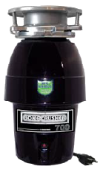
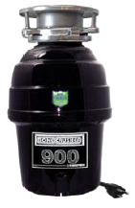
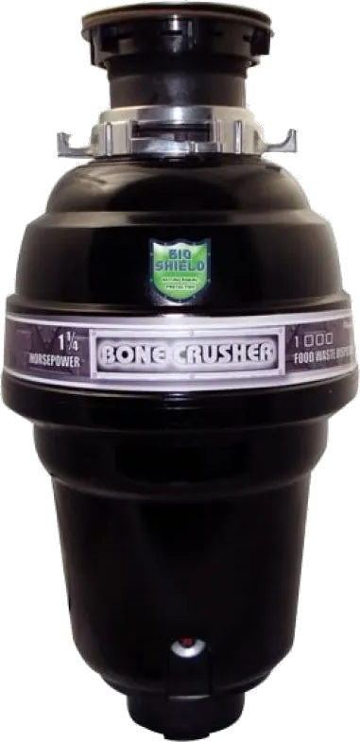
Competitor Comparison – Bonecrusher
 | BLANCO FWD Lite​ | Model 700 | BLANCO FWD Medium​ | Model 900 | BLANCO FWD Max ​ | Model 1000
Horse power​ | 0,5 HP​ | 0,5 HP​ | 0,75 HP​ | 0,75 HP​ | 1 HP​ | 1,25 HP
Power​ | 370 W​ | no information | 550 W​ | no information | 750 W​ | no information
Motor​ | AC induction motor​ | DC motor | AC induction motor​ | DC motor | AC induction motor​ | DC motor
Mains voltage NA products​ | 120V/60Hz​ | 120V/60Hz | 120V/60Hz​ | 120V/60Hz | 120V/60Hz​ | 120V/60Hz
Mains voltage all other products​ | 230V/50Hz​ | 120V/60Hz | 230V/50Hz​ | 120V/60Hz | 230V/50Hz​ | 120V/60Hz
plug pre-installed ​ | x​ | x | x​ | x | x​ | x
3 bolt installation​ | x​ | x | x​ | x | x​ | x
Material grinding components​ | stainless steel​ | stainless steel​ | stainless steel​ | stainless steel​ | stainless steel​ | stainless steel​
Number of grinding stage​ | 2​ | no information | 3​ | no information | 3​ | no information
Volume grinding chamber​ | 900 ml​ | no information | 1200 ml​ | no information | 1200 ml​ | no information
Automatic shutdown function​ | x​ | - | x​ | - | x​ | -
Automatic shutdown time​ | max. 25 min (when idle)​ | - | max. 25 min (when idle)​ | - | max. 10 min (when idle)​ | -
Auto-reverse function​ | -​ | no information | -​ | no information | x​ | no information
Feeding type​ | continuous​ | continuous​ | continuous​ | continuous | continuous​ | continuous
Noise level​ | standard (<70 dB) | no information | quiet (<60-70 dB​) | no information | very quiet (<60 dB​) | no information
Dishwasher connection/ connectable​ | x​ | x | x​ | x | x​ | x
Overload protection​ | x​ | no information | x​ | no information | x​ | no information
Size (H x W) [mm] | 320 x 180 | 327,66 x 177,8 | 335 x 203 | 360,68 x 218,44 | 335 x 203 | 393,7 x 220,98

Slide 27
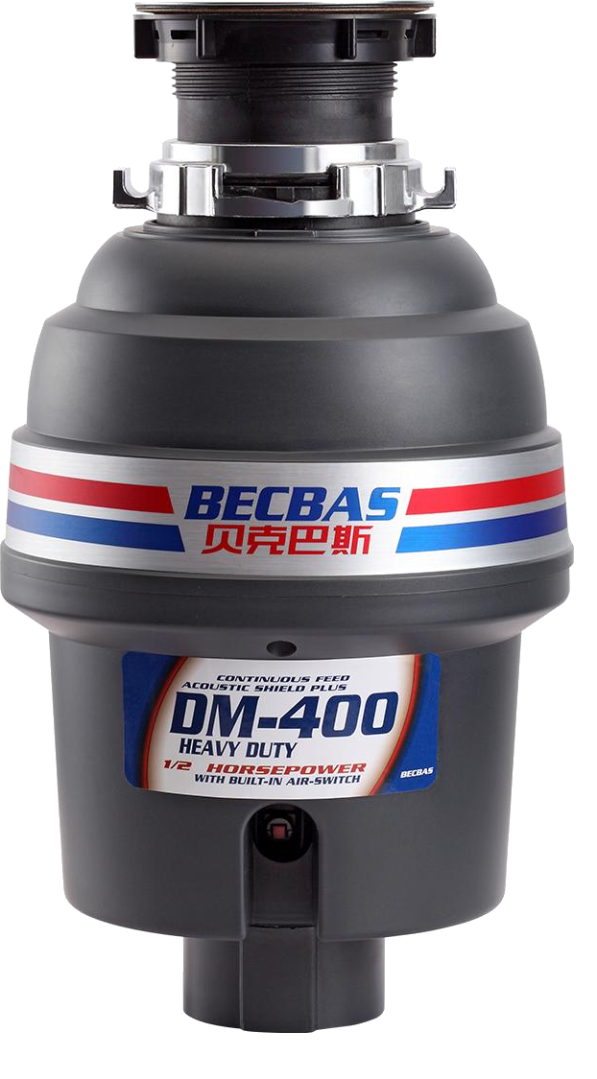
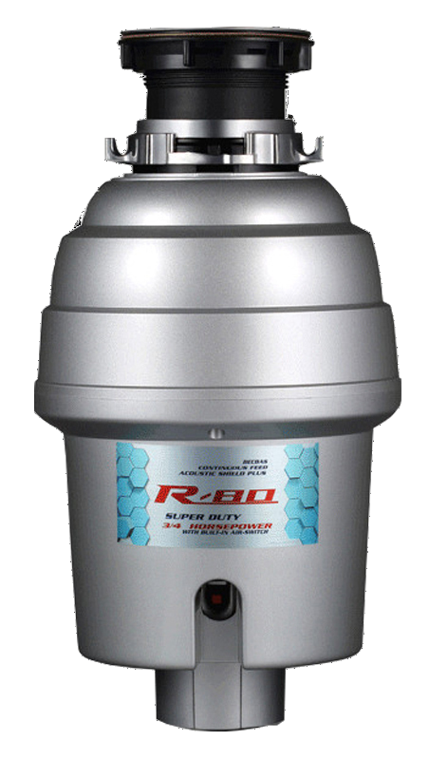
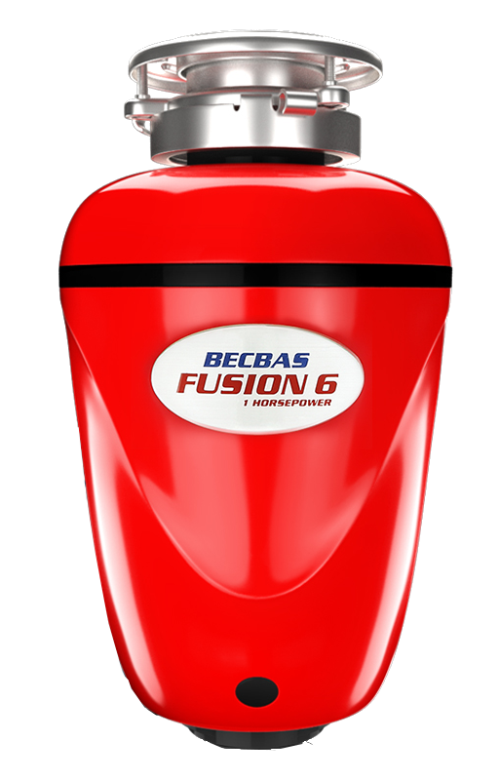
Competitor Comparison – Becbas
 | BLANCO FWD Lite​ | DM400 | BLANCO FWD Medium​ | R80 | BLANCO FWD Max ​ | Fusion 6
Horse power​ | 0,5 HP​ | 0,5 HP | 0,75 HP​ | 0,75 HP​ | 1 HP​ | 1 HP​
Power​ | 370 W​ | no information | 550 W​ | no information | 750 W​ | no information
Motor​ | AC induction motor​ | DC motor | AC induction motor​ | DC motor | AC induction motor​ | DC motor
Mains voltage NA products​ | 120V/60Hz​ | no information | 120V/60Hz​ | no information | 120V/60Hz​ | 120V/60Hz​
Mains voltage all other products​ | 230V/50Hz​ | 220V/50-60Hz | 230V/50Hz​ | 220V/50Hz | 230V/50Hz​ | 220V/50Hz
plug pre-installed ​ | x​ | x​ | x​ | x​ | x​ | x
3 bolt installation​ | x​ | - | x​ | - | x​ | x
Material grinding components​ | stainless steel​ | stainless steel​ | stainless steel​ | stainless steel​ | stainless steel​ | steel
Number of grinding stage​ | 2​ | 1 | 3​ | 2 | 3​ | 2
Volume grinding chamber​ | 900 ml​ | 1000 ml | 1200 ml​ | 1200 ml​ | 1200 ml​ | 1300 ml
Automatic shutdown function​ | x​ | manual reset button | x​ | manual reset button | x​ | manual reset button
Automatic shutdown time​ | max. 25 min (when idle)​ | - | max. 25 min (when idle)​ | - | max. 10 min (when idle)​ | -
Auto-reverse function​ | -​ | -​ | -​ | -​ | x​ | -​ (but possible)
Feeding type​ | continuous​ | no information | continuous​ | no information | continuous​ | no information
Noise level​ | standard (<70 dB) | 25-35 db | quiet (<60-70 dB​) | no information | very quiet (<60 dB​) | no information
Dishwasher connection/ connectable​ | x​ | x​ | x​ | x​ | x​ | x
Overload protection​ | x​ | x​ | x​ | x​ | x​ | x
Size (H x W) [mm] | 320 x 180 | 390,5 x 219,7 | 335 x 203 | 413,1 x 220,1 | 335 x 203 | 358,9 x 220

Slide 28
FAQ
What are the benefits of FWD?
  FWD are hygienic, clean and very convenient when it comes to disposing of food waste quickly and odorless.
  FWD reduce the amount of waste in the organic waste bin which prevents the formation of bacteria and avoids vermin infestation around the bin.
What should I pay attention to when using the FWD?
  Always use cold water when disposing of waste.
  Only fill the disposer with organic and prescribed food.
  Permission must be granted to transfer finely chopped food waste into the sewer system.
What are the risks of a FWD?
  Do not reach into the running FWD.​
  Take care that no metallic objects (e.g.cutlery or jewellery) fall into the FWD.
  Make sure that the splash guard is in place so that food does not fly out. ​
  Do not run the FWD without water.
  Do not let children use the FWD unsupervised.

Slide 29
FAQ
Are FWD noisy?
  Our BLANCO FWD units are quieter compared to other kitchen waste disposers. The noise level depends on what is being disposed of.
What can I throw into the FWD?
  Our BLANCO FWDs shred and dispose of most food waste effortlessly in seconds.
  Certain types of food (woody and long-fibre waste such as pineapple, celery or rhubarb) are not recommended for the BLANCO FWD Lite.
How to take care of the FWD?
  Use only cold water.
  It is recommended to clean the protective sleeve at least once a week with conventional washing-up liquid (also suitable for dishwasher).
  We recommend to clean the FWD every 2 to 3 months - use only gentle detergents
  If waste remains stuck, switch off the FWD and carefully remove the food residues (e.g. with a fork) from the grinding chamber. Alternatively, some stuck food can be removed by grinding ice cubes or lemon peels.
How can I counteract odors?
  Over time, dirt can accumulate around the protective sleeve (e.g. grease, food residues), which inevitably leads to odors.
  To counteract odors, ice cubes can be added to the disposer along with pieces of lemon or lime. Alternatively, you can use citric acid, baking soda or gentle detergents.

Slide 30
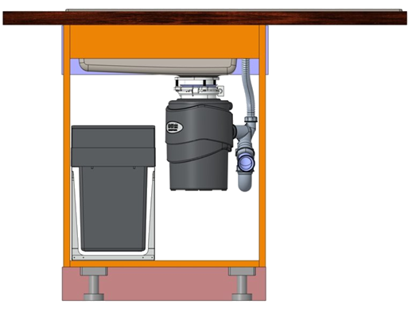
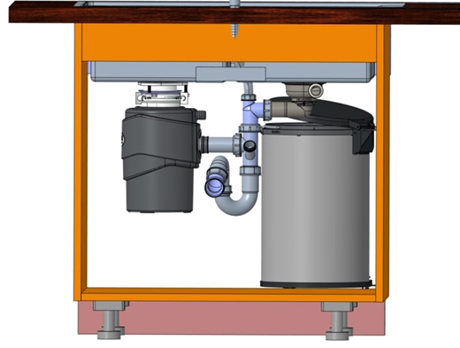
FAQ
What are the prerequisites to install a waste system when having a FWD?
  You need a cabinet width of at least 60 cm.
  The waste system depends on the installed door system (hinged door / drawer / pull-out front).
  Further, it depends on where the drain is positioned. If it is in the middle, a waste systems will fit in cabinets with a width of 90 cm or more. If the drain is on the right/left, you can use:
    Botton II (60 cm cabinet width)
    Singolo XL (80 cm cabinet width)
METRA XL 6S with Botton II
DIVON II 8S-IF with Singolo XL

Slide 31
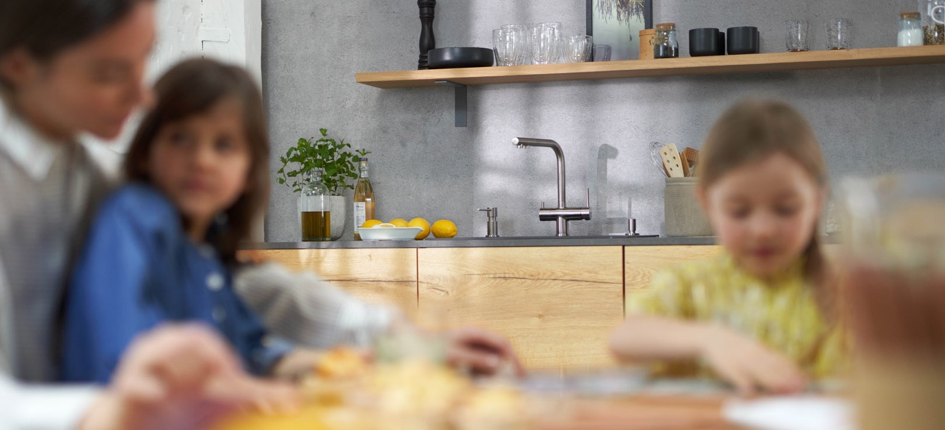
THANK YOU
FOR YOUR
ATTENTION.

