Slide 1
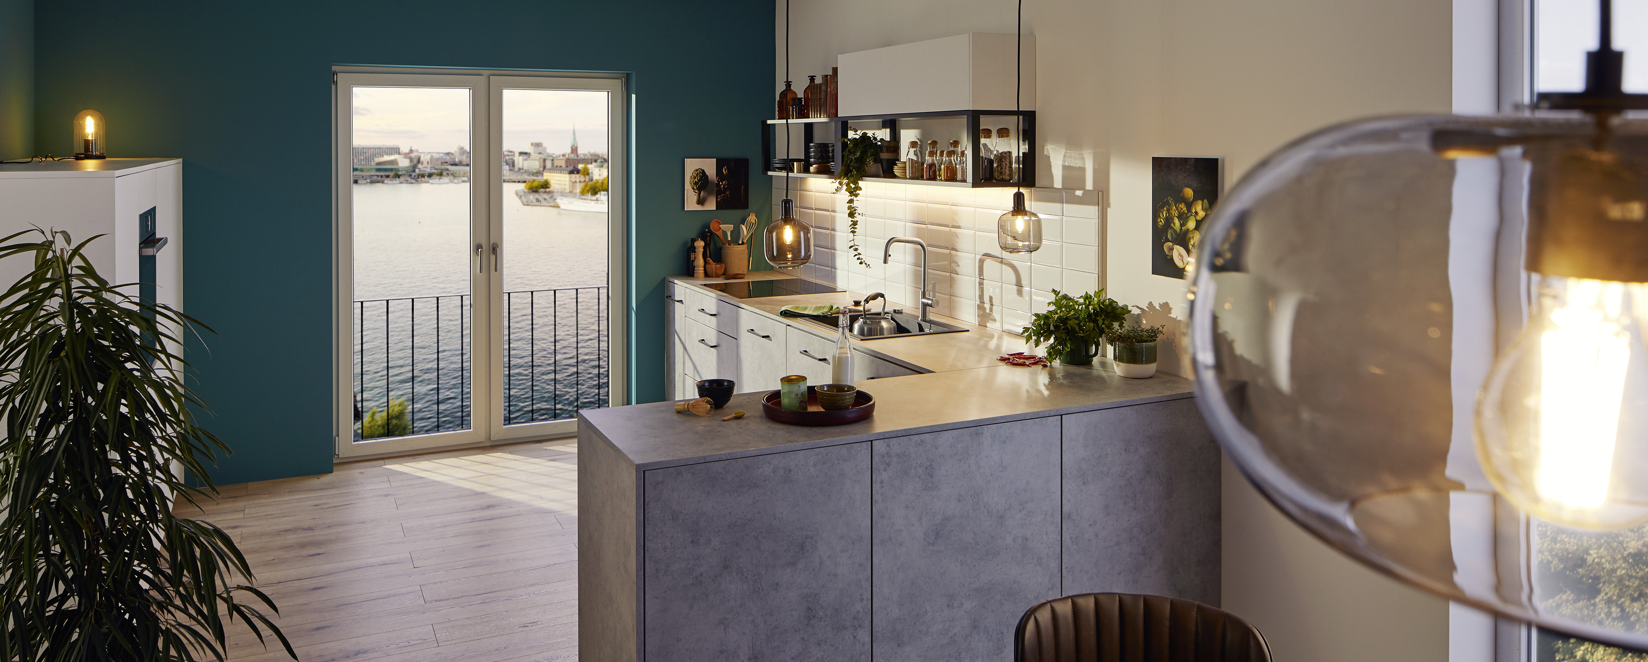
BLANCO SILGRANIT Cleaning Set
Novelty presentation
2022/08/31 | JELS | PRODUCT PRESENTATION | SILGRANIT Cleaning Set | EN

Slide 2
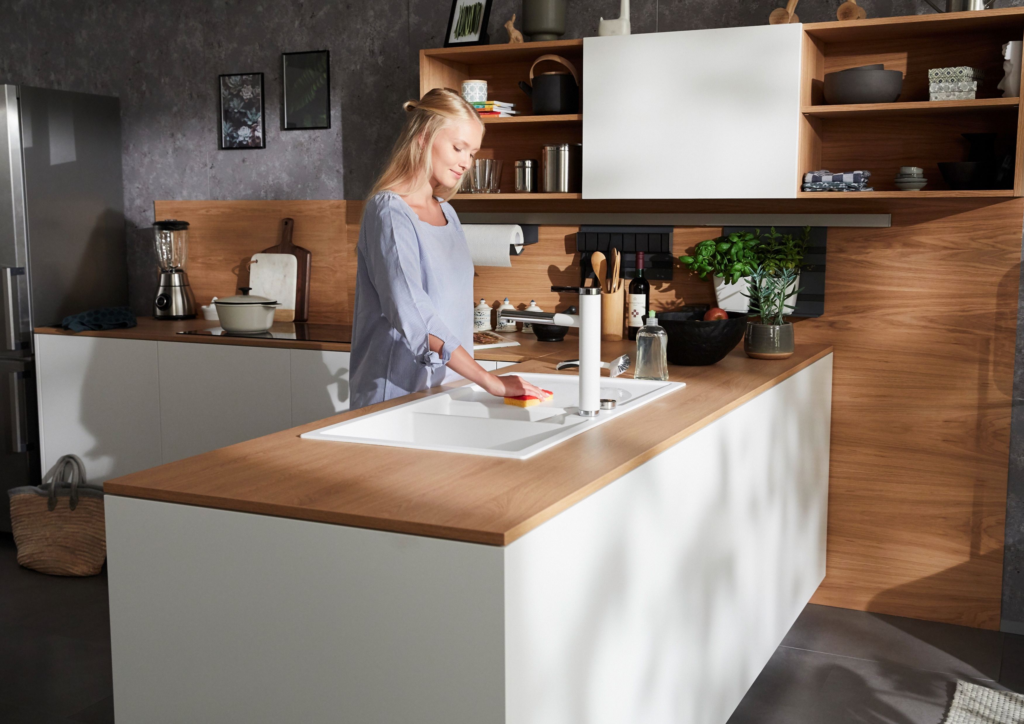
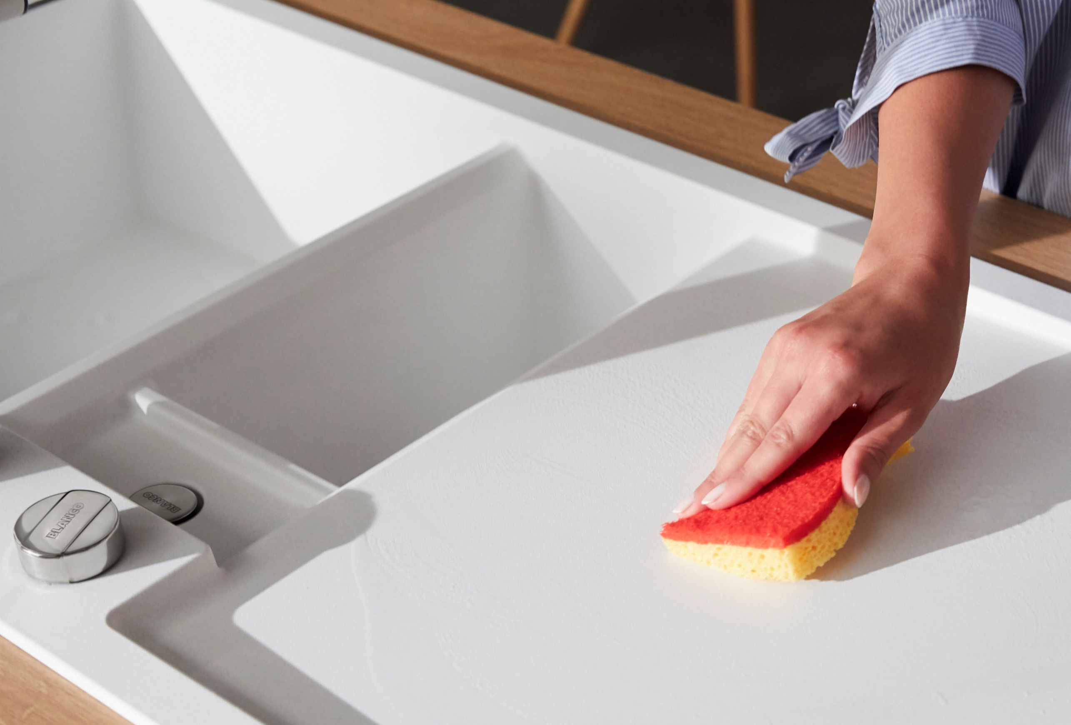
Professional cleaning products
BLANCO CARE – Perfect care made easy

Slide 3
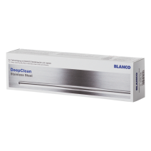

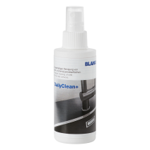
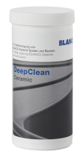

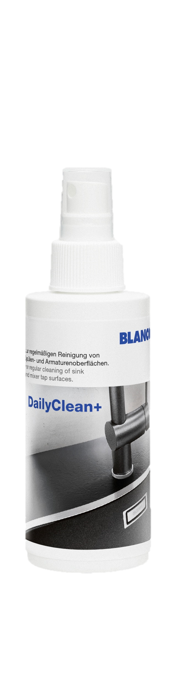
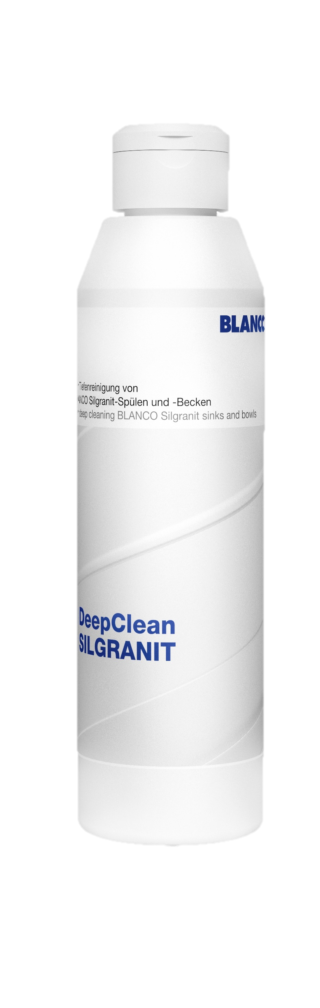
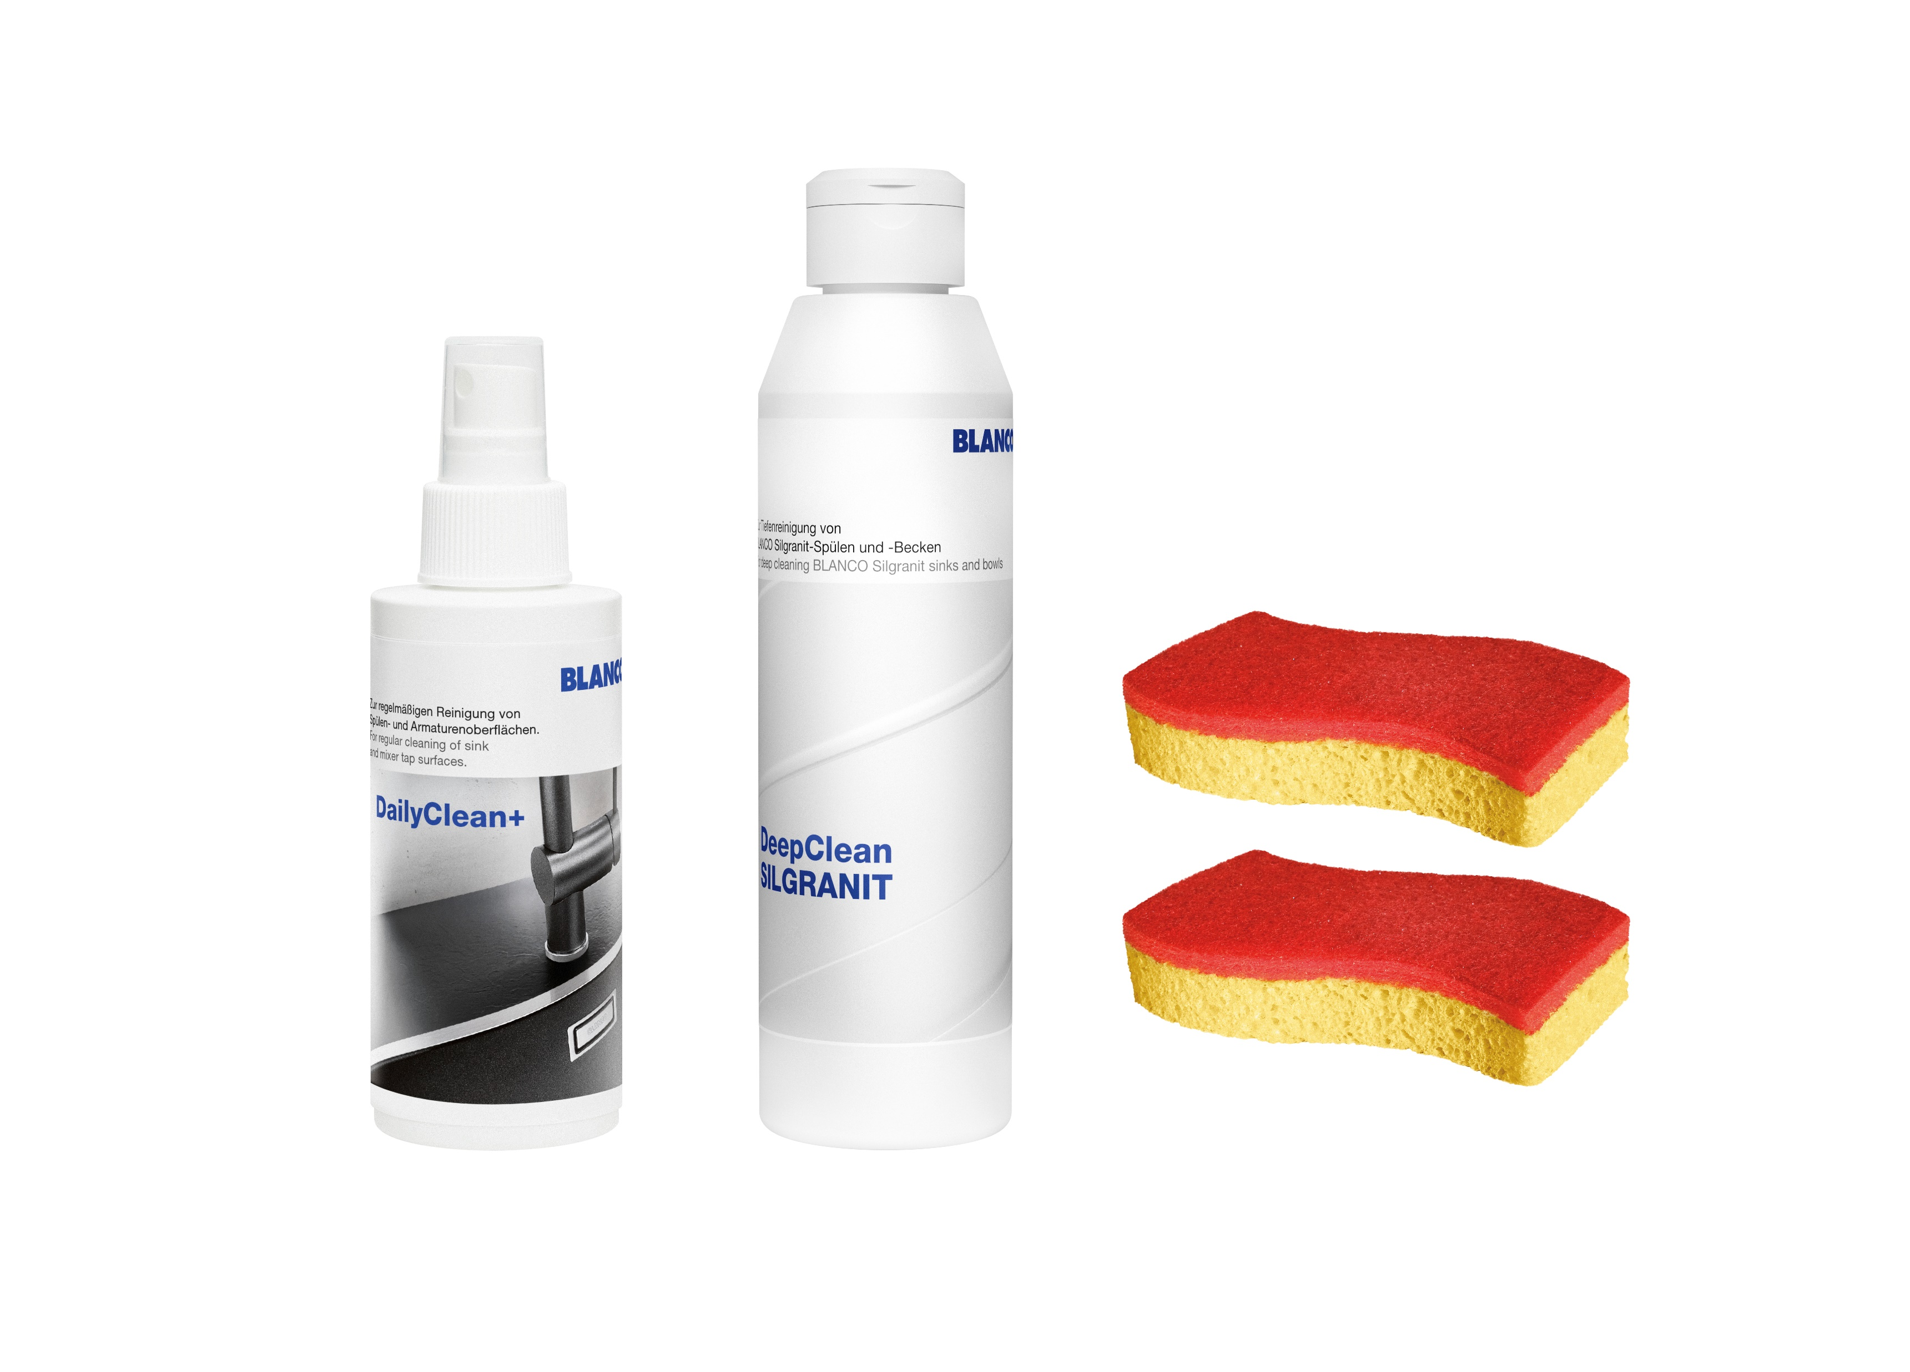

Cleaning concept in two steps
CARE product line
Daily Cleaning
Deep Cleaning
For cleanliness and hygiene at the Water Place
Lasting care with minimum effort
Specially developed and tested for BLANCO sinks and mixer taps
For a long-lasting cared look and preservation of the material structure
Cleaning with common household cleaners
DailyClean+
Professional limescale remover for all surfaces
DeepClean
To be used for stubborn dirt
DeepClean
Stainless Steel
DeepClean
Ceramic
DailyClean+ and DeepClean
Improved formulas
Easy to use
Professional results
NEW
Silgranit
Cleaning Set
BLANCO Microfiber cloth

Slide 4
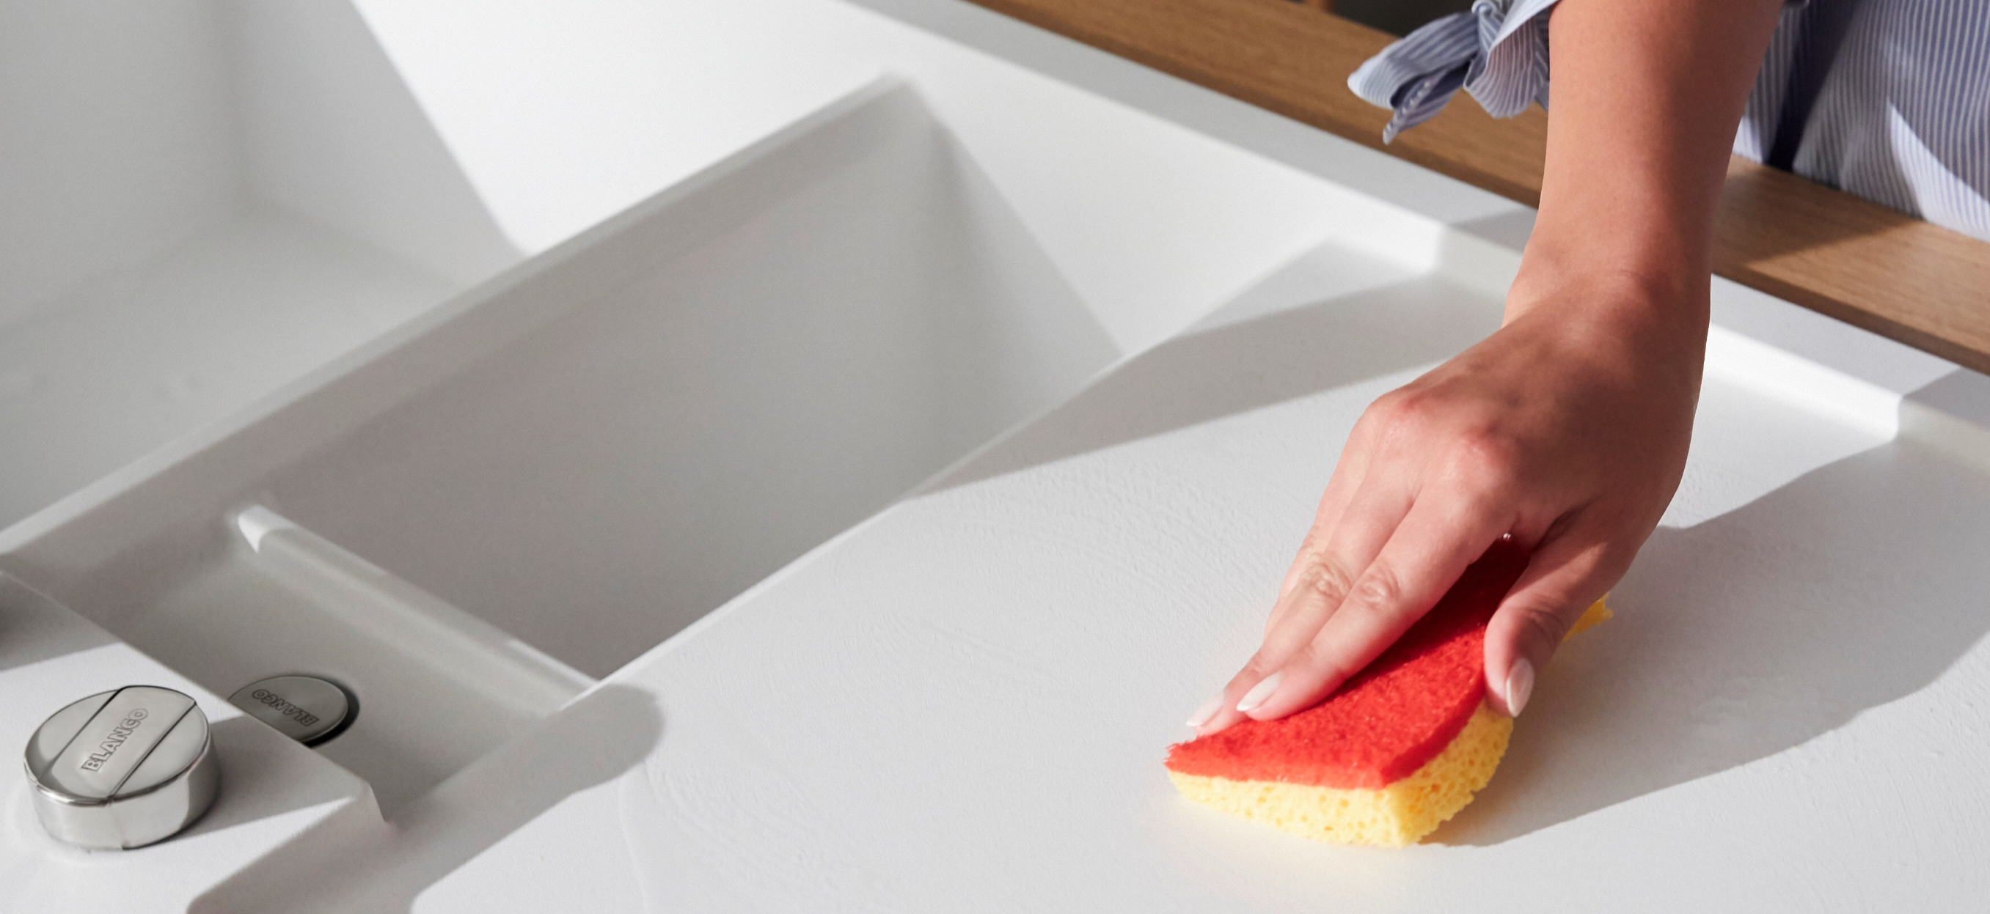
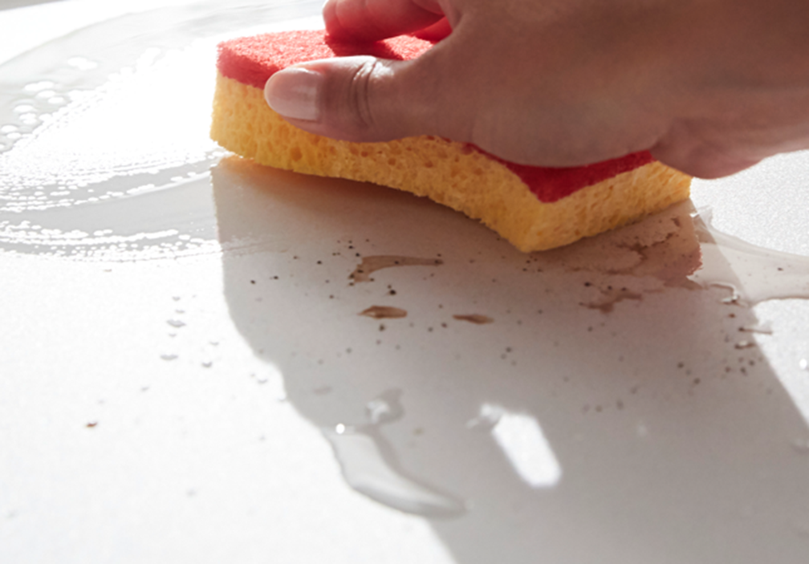
BLANCO Silgranit Cleaning Set
Developed for everyone who cares about tidiness and hygiene at the kitchen water place
All-in-one cleaning set for
BLANCO SILGRANIT sinks and bowls
Reducing and removing discoloration, stains and stubborn dirt
Developed, tested and proven for SILGRANIT sinks and bowls
Combining forces for an excellent result

Slide 5

Silgranit Cleaning Set
All-in-one cleaning set for BLANCO SILGRANIT sinks and bowls
NEW
Surface | SILGRANIT
Effect | Removing limescale, grease and starch deposits on Silgranit sinks and bowls
Scope | 1 x 250 ml DeepClean Silgranit 1 x 150 ml DailyClean+ 2 x Spontex Sponge red
Not suitable for | SILGRANIT-Look mixer taps
Use | Spray DailyClean+ on entire sink, let it work (5 min) and then wipe off with a microfiber cloth. Apply DeepClean Silgranit with the red sponge, leave it to work (5 min). Moisten Sponge and clean the entire sink with the red side. Rinse away any residue and rub dry with a microfiber cloth.
Traditional distribution

Slide 6
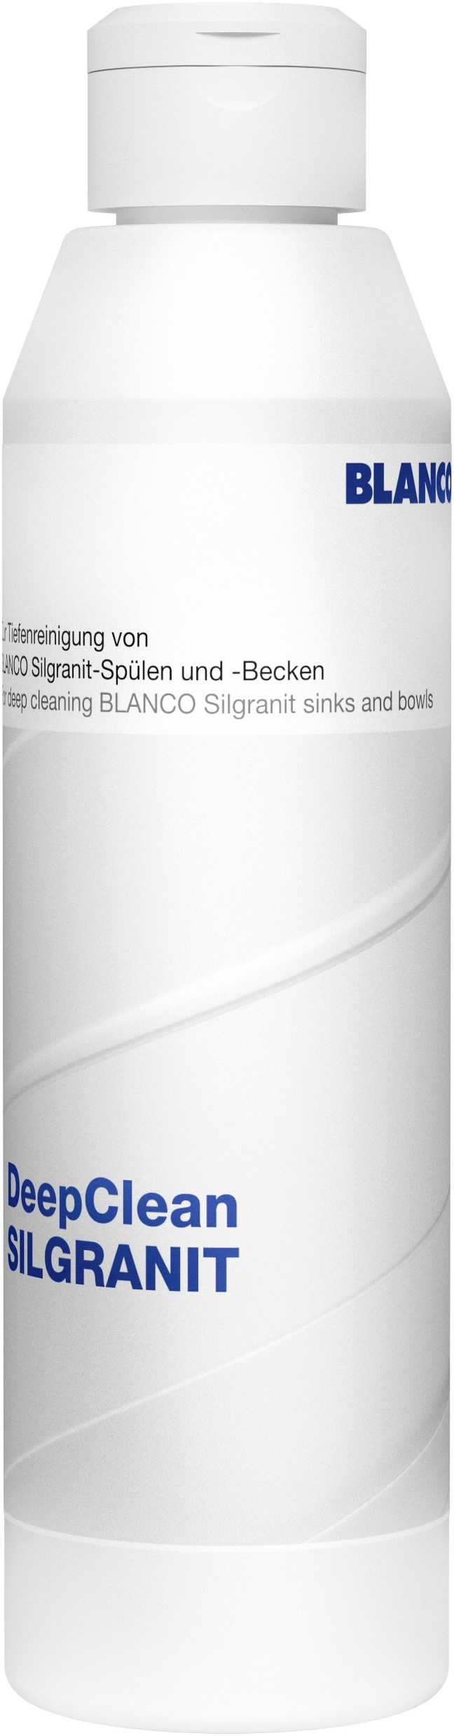

DeepClean Silgranit
Replacement Bottle for BLANCO SILGRANIT Cleaning Set
NEW
Surface | SILGRANIT
Effect | Removing grease and starch deposits
Scope | 1 x 250 ml DeepClean Silgranit
Not suitable for | SILGRANIT-Look mixer taps
Use | Descale the sink thoroughly with DailyClean+ before use. Apply DeepClean Silgranit with the red sponge, leave it work (5 min). Moisten Sponge and clean the entire sink with the red side. Rinse away any residue and rub dry with a microfiber cloth.
Owned web-shop only

Slide 7
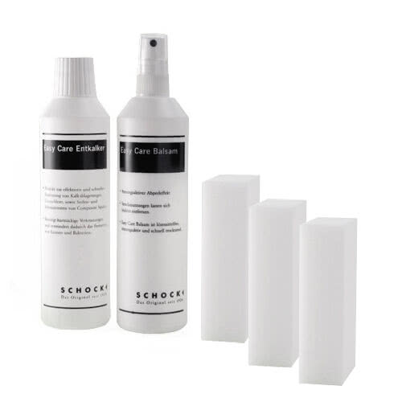
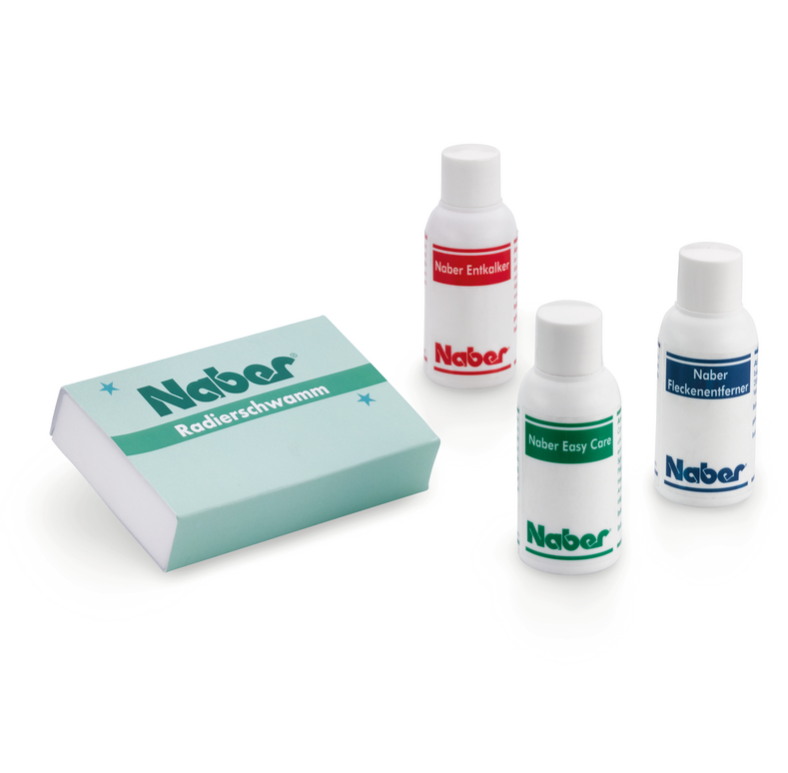
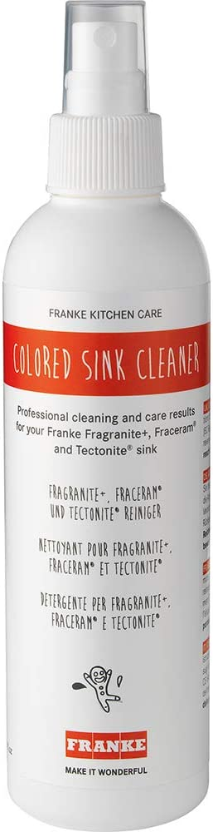
How do we stand against competition?
 | SILGRANIT Cleaning Set | Schock Easy Care* | Naber Care-Set Sin-Nagranit* | Franke Colored Sink Cleaner*
Developed & tested for Silgranit | Yes | No | No | No
Removing limescale | Yes | Yes | Yes | Yes
Removing grease & starch | Yes | No | No | No
Procedure | Ready-to-use | Ready-to-use | Single Use | Single Bottle
Conformity | EU (10 countries) | DE/AT only | DE/AT only | EU (8 countries)
Volume | 150 ml 250 ml | 2 x 250 ml | 3 x 50 ml | 250 ml
NEW
  *Based on manufacturers information and own testing results (11/2021)
Notes:
Nochmal drüber schauen, mit partly ergänzen

Slide 8
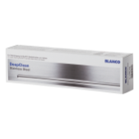



Positioning, Availability and Products
  Positioning
  Availability
  Since September 2022
  Inventories of previous BLANCO ACTIV is expected to last until Dec. 2022.
  Products
  Silgranit Cleaning Set*
  DeepClean Silgranit*
Deep
Clean
Daily
Clean+
Common household cleaners
* Instruction for use, safety data sheets of products and labels on product containers are available in 8 languages (DE/EN/ES/FR/IT/NL/PT/RU) and therefore accepted for legal marketability in countries according to their official languages.

Slide 9
Article Numbers
New Article Number | Product | Comment
527033 | Silgranit Cleaning Set | Available for all channels and customers
527034 | DeepClean Silgranit | Own Shops only as refill for 527033
520 784 | BLANCO ACTIV Powder* | Left over stock 17 kpces – no reordering at supplier!
  *Available to order until 31.03.2023 if not out of stock before

Slide 10
Thank You.
WHERE
LIFE TAKES
PLACE.
EVERYDAY.
2022/08/31 | JELS | PRODUCT PRESENTATION | SILGRANIT Cleaning Set | EN

Slide 11
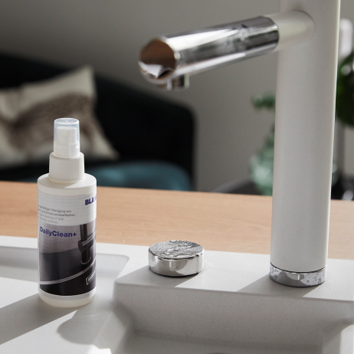
DailyClean+
The Professional Limescale Remover
Surface | All BLANCO sinks and mixer taps
Effect | Removes stubborn limescale stains
Size | 150 ml spray bottle
Cloth/Sponge | Microfiber cloth
Use | Simply spray it on, leave it to take effect and wipe it off with a microfiber cloth

Slide 12
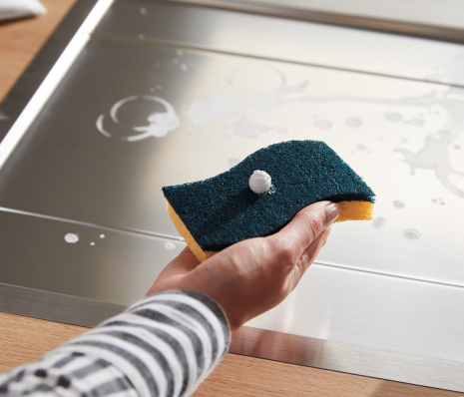
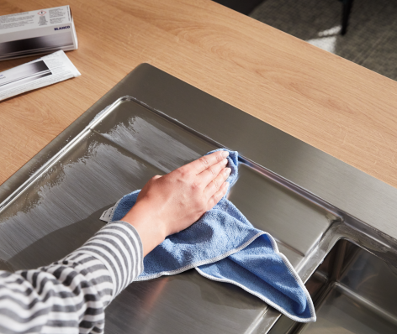
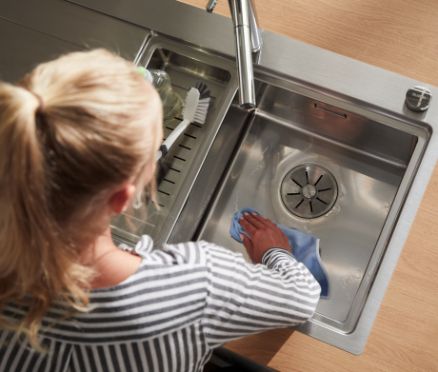
DeepClean Stainless Steel
For stubborn Dirt
Surface | Stainless steel
Effect | Removes small scratches, extraneous rust and stains Allows water to run off, prevents fingermarks and dirt
Size | 150 ml metal tube
Cloth/Sponge | Microfiber cloth, Spontex Sponge green
Not suitable for | Durinox, natural finish, linen, chrome-plated surfaces and mixer taps
Use | Apply it with a sponge, polish in the brushing direction and clean it with water

Slide 13
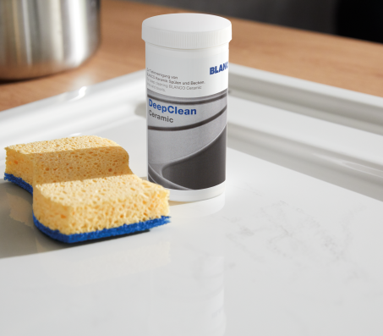
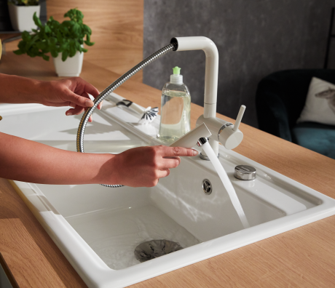
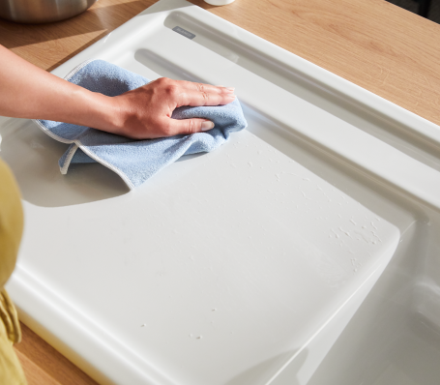
DeepClean Ceramic
For Maximum Value Preservation of Ceramic Sinks
Surface | Ceramic
Effect | Dissolves grease, limescale blemishes and metal abrasion Polishes and preserves
Size | 100 g powder dispenser
Cloth/Sponge | Microfiber cloth, Spontex Sponge blue
Also suitable for | Stainless steel sinks in a natural finish or linen, plus ceramic cooktops
Use | Spread powder on the sink, work it into the surface with a damp sponge and clean it with a cloth

