Slide 1
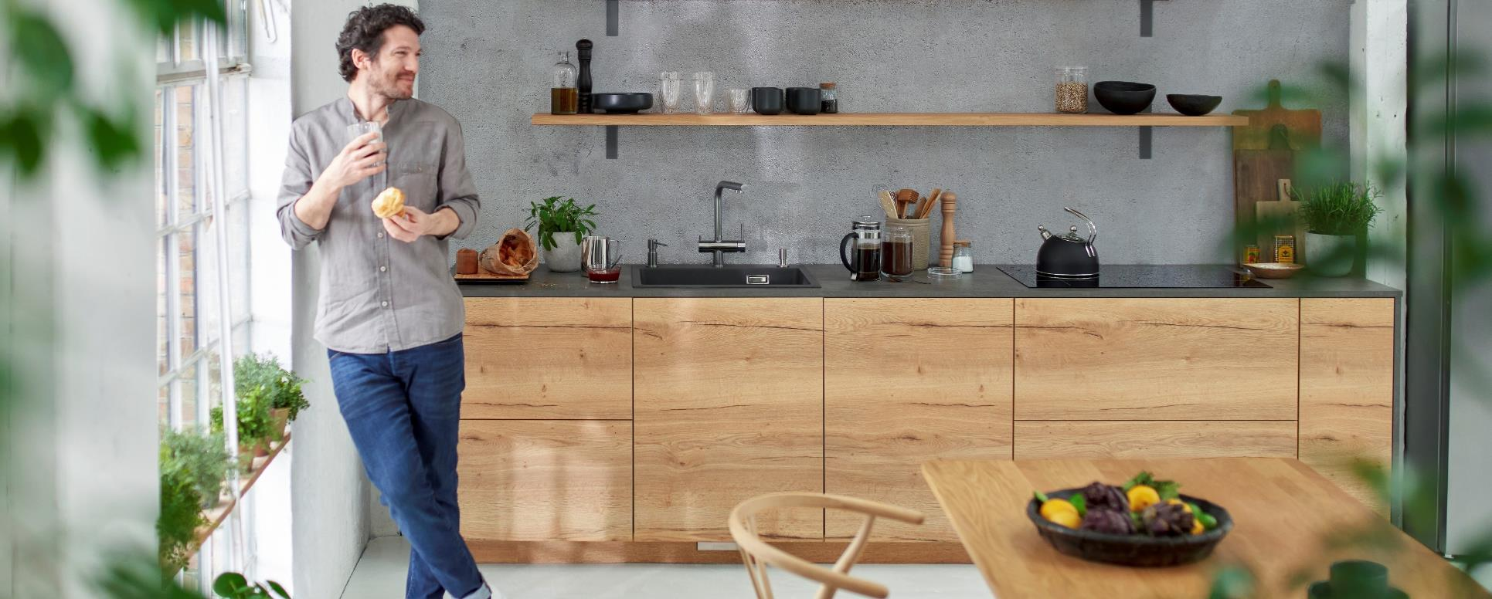
BLANCO Orga Shelf
Novelty Presentation
12.09.2022 | MHAB, JRIN |

Slide 2
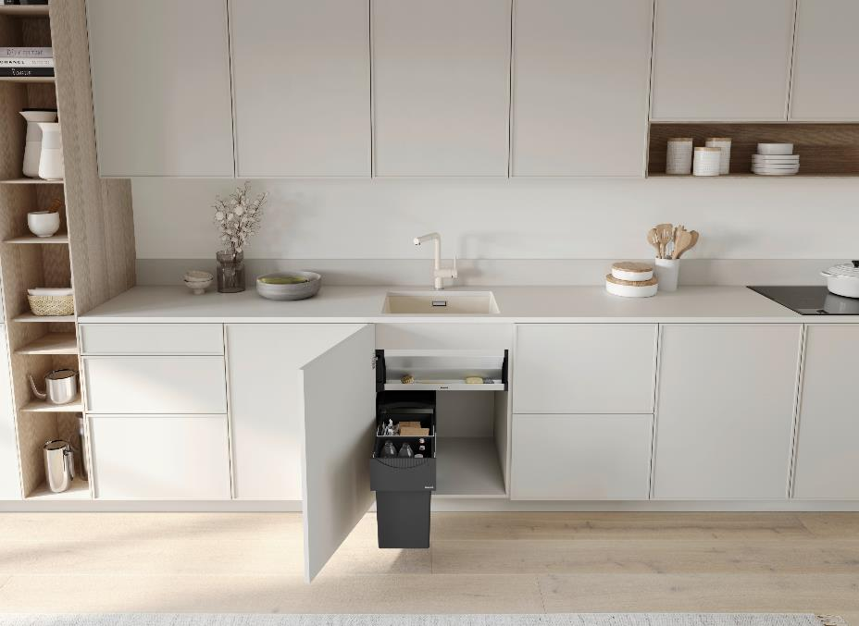
Agenda
1
Orga Shelf at a glance
2
Reason why – Strategic background
3
Planning Information
4
Installation instructions
5
UNIT Inspirations
6
Availability & Models

Slide 3
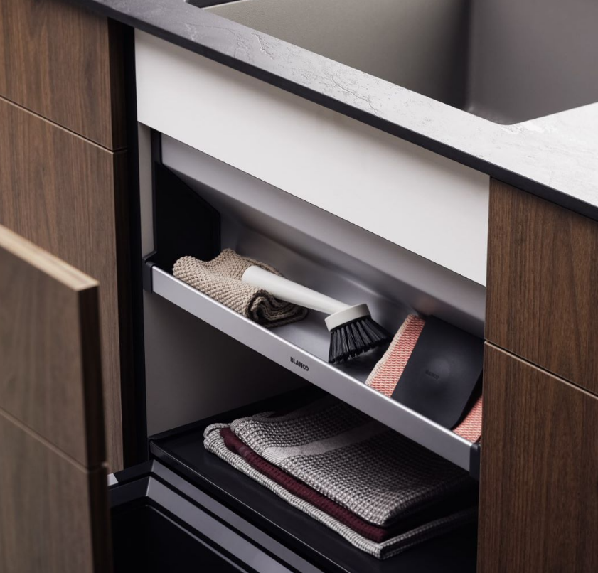
Orga Shelf at a glance
Main characteristics
Keeps the sink and cabinet organized and tidy​
Slim shelf on the top of the cabinet provides extra space for storing sink utensils like brushes, sponges and waste bags​
Quick access to stored items at ergonomic reach​
Matches other cabinet organization components like SELECT II and FLEXON II​
Visual cover, optically enhancing the base cabinet ​

Slide 4
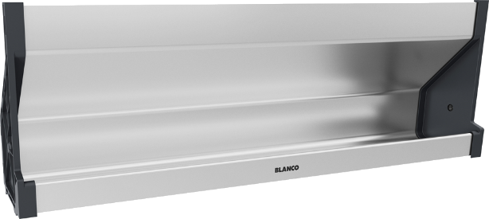
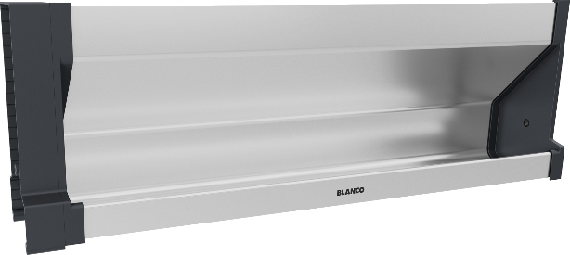
BLANCO Orga Shelf 60
Orga Shelf 60 P
The Orga Shelf is an aluminum rack with plastic side elements. ​
There are two models available:
Orga Shelf 60 P (for pull-out fronts)
Orga Shelf 60 H (for hinged doors)
Orga Shelf 60 H
with hinge cover for left/right side

Slide 5
Reason why
Strategic background of the launch of the BLANCO Orga Shelf 60
Implementation of the UNIT strategy by adding new functionality in the base cabinet
Cabinets next to the sink cabinet are used for waste treatment and organisation
Provide options for organization in the sink base cabinet
Using the complete available space

Slide 6
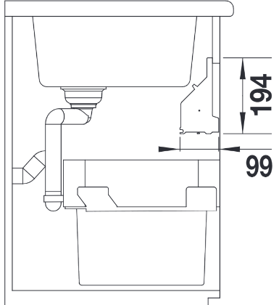
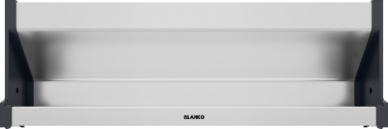
Planning Information valid for P and H version
Important dimensions
The BLANCO Orga Shelf is designed for a 60 cm cabinet and fits all door connections
Flexible plastic end caps for the use with cabinet sidewall thicknesses from
16 mm to 19 mm (Orga Shelf width: 562 – 568 mm)​.
To be installed behind the crossbeam, covering the sink.
Flexible height adjustment possible.
Height adjustment can be restricted by mounting brackets behind
the crossbeam.
​Distance between the crossbeam and the sink should be minimum 7 mm.
Cabinet height of min. 780 mm recommended.
min. 7
50
∡45°
Side view sink base cabinet
562 - 568 mm

Slide 7
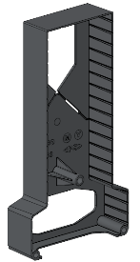
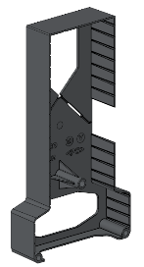
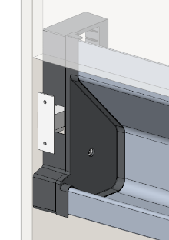


Planning Information
Speciality for hinged door version
Special requirements for hinged door version:
Maximum thickness of hinges 30 mm​.
Universal use regardless if hinges are left or right sided.
Includes a hinge cover which can be adjusted according to variable height positions of the hinges​.
Universal use of the hinge cover
Variable height depending on hinge position
C
C
Hinge cover can be cut out at the required position of the hinge using the cutting grooves (C)

Slide 8
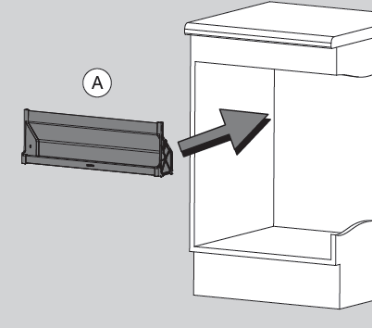
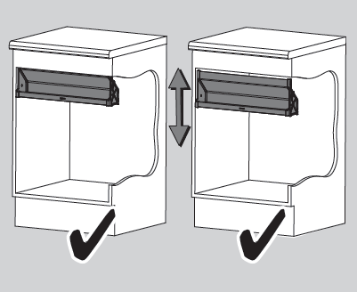
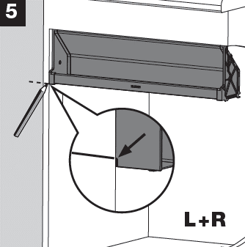
How to install the BLANCO Orga Shelf 60?
As easy as
1
2
3
1
Find the right position for the Orga Shelf

Slide 9
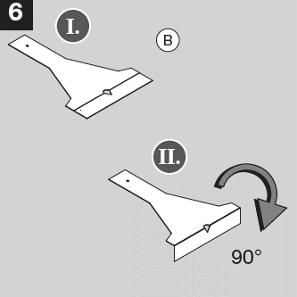
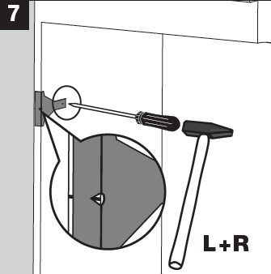
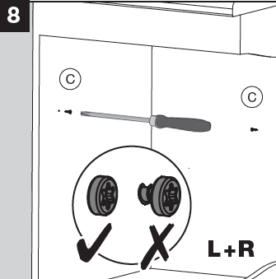
How to install the BLANCO Orga Shelf 60?
As easy as
1
2
3
2
Place the supporting screw

Slide 10
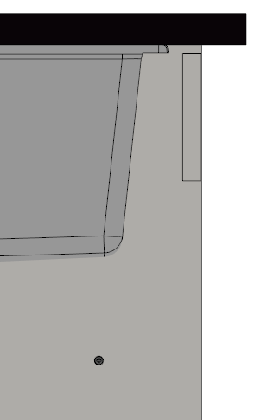
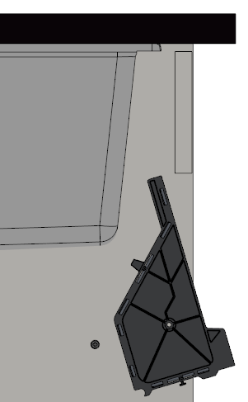
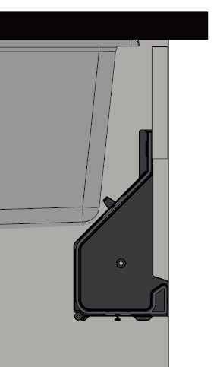
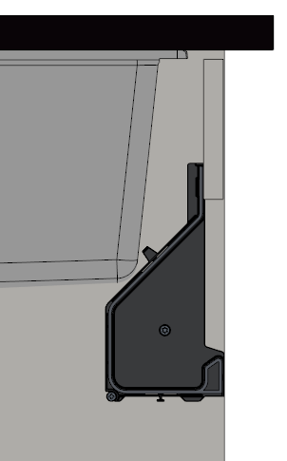



How to install the BLANCO Orga Shelf 60?
As easy as
1
2
3
3
Installation of the Orga Shelf
Already placed supporting screw
Swivel Orga Shelf between sink and crossbeam
Place Orga Shelf on supporting screw and push against crossbeam
Place fixation screws left and right

Slide 11
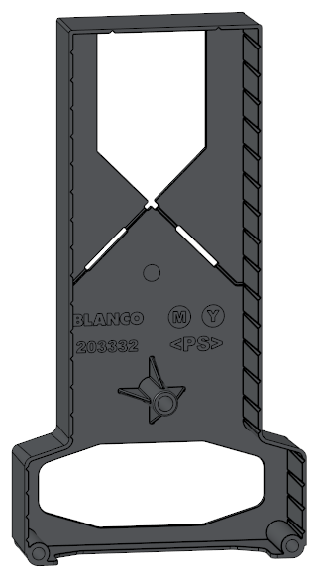
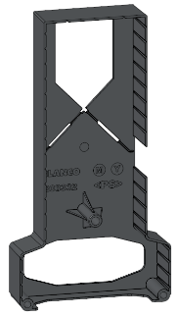
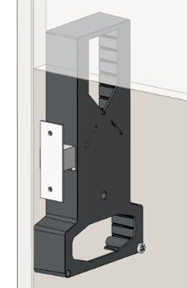
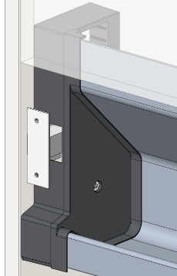
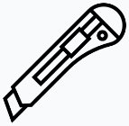

How to install the BLANCO Orga Shelf 60?
Speciality: Installation with a hinged door adapter
Hinge adapter is designed reversibly so it can be used for right- or left sided hinged fronts.
The hinges can be placed at different heights in the cabinet.
Check the height of the hinge in the cabinet.
Cut out the space on the door adapter accordingly.
For easier cutting, use the cutting grooves (C).
C
C
Hinged door adapter

Slide 12
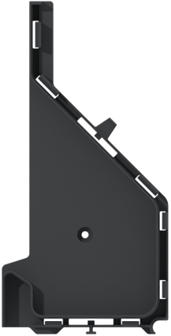
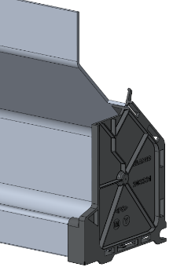
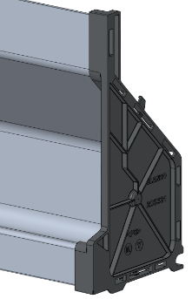
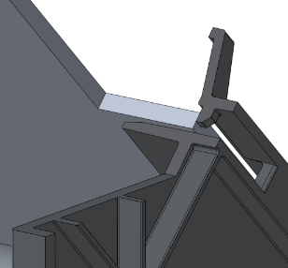
Adaptation to wall thickness 16 mm / 19 mm
Profile caps (left and right) can be clamped upon the profile against two different positions, which vary by 3 mm each.
Installation in a cabinet with 16 mm side wall thickness
No adjustment required
Profile caps (left and right) are pre-assembled to the aluminum profile in
16 mm installation position (profile pushed against stop positions)
Installation in a cabinet with 19 mm side wall thickness
The plastic nose at the stop position (S) needs to be pulled/pushed to gain
3 mm of space on each side. This allows the profile to be pushed further into the cap, reaching the required overall length for installation in the cabinet.
S
S
Profile cap

Slide 13
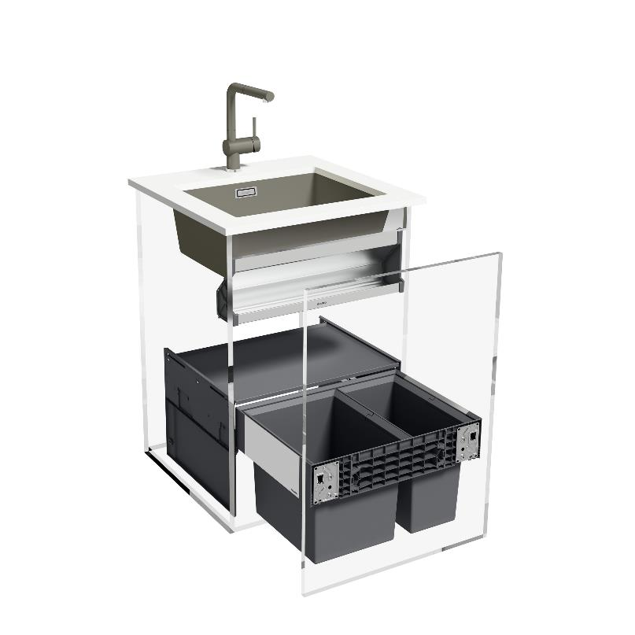
In Harmony with Sink and Mixer Tap​
BLANCO UNIT based on selected Models*
Creating a BLANCO UNIT by combining the following products:
Tap | LINUS-S
Sink | SUBLINE 500-U
Waste system | SELECT II 60/2
Organisation | Orga Shelf 60 P
*This overview does not replace a dimensional check.

Slide 14
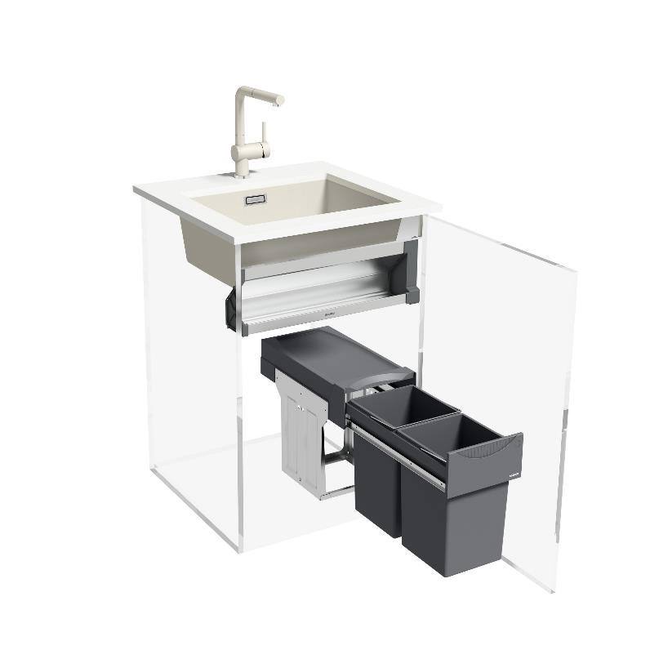
In Harmony with Sink and Mixer Tap​
BLANCO UNIT based on selected Models*
Creating a BLANCO UNIT by combining the following products:
Tap | LINUS-S
Sink | SUBLINE 500-U
Waste system | BOTTON II 30/2
Organisation | Orga Shelf 60 H
*This overview does not replace a dimensional check.

Slide 15

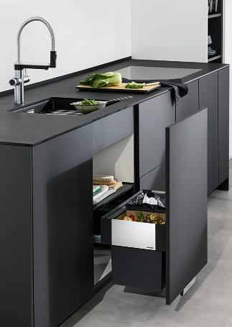
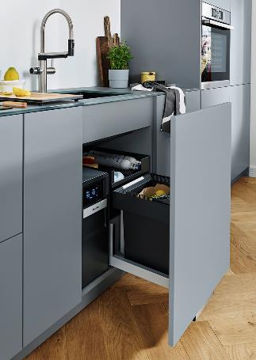
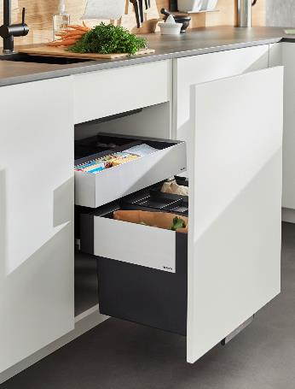
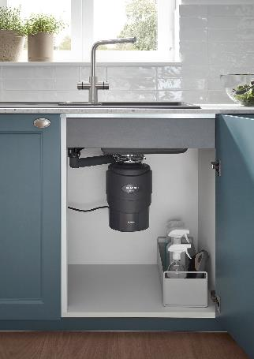
Further combination ideas
Select II Compact
No Orga drawer available, the Orga Shelf can fill up the empty space.
Select II Soda
Further space for organization is available as CO₂ cylinders are often stored lying down in the drawer.​
Select II Orga / Flexon II
Mostly there is enough space in the upper part, as cabinets tend to be higher (minimum height: 78 cm).
FWD
Covers the FWD optically and uses already available space in the cabinet.

Slide 16


Positioning, Availability and Models
  Positioning
  Availability
  Models
  BLANCO Orga Shelf 60 P
  Item No. 527458
  BLANCO Orga Shelf 60 H
  Item No. 527459
Best
Available for Order
All regions | from CW 02/2023
BLANCO Orga Shelf
Better
Good

Slide 17
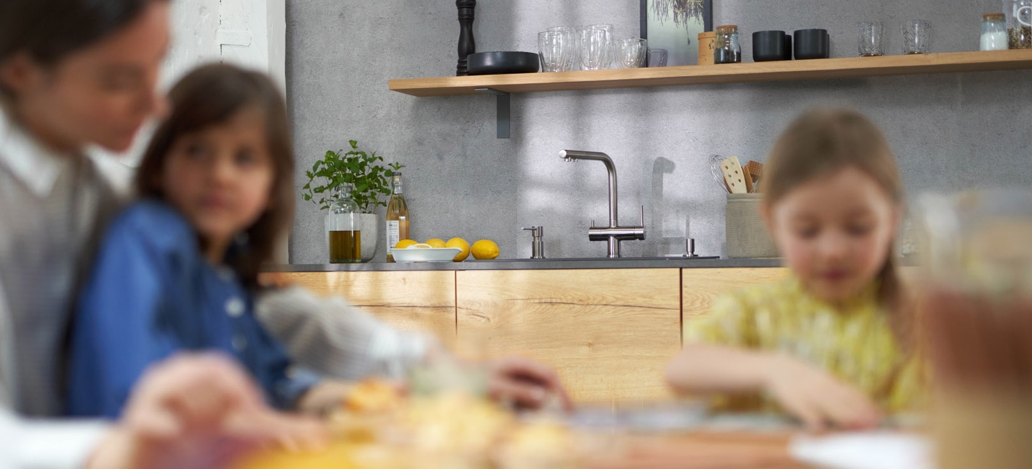
THANK YOU
FOR YOUR
ATTENTION.

