Slide 1
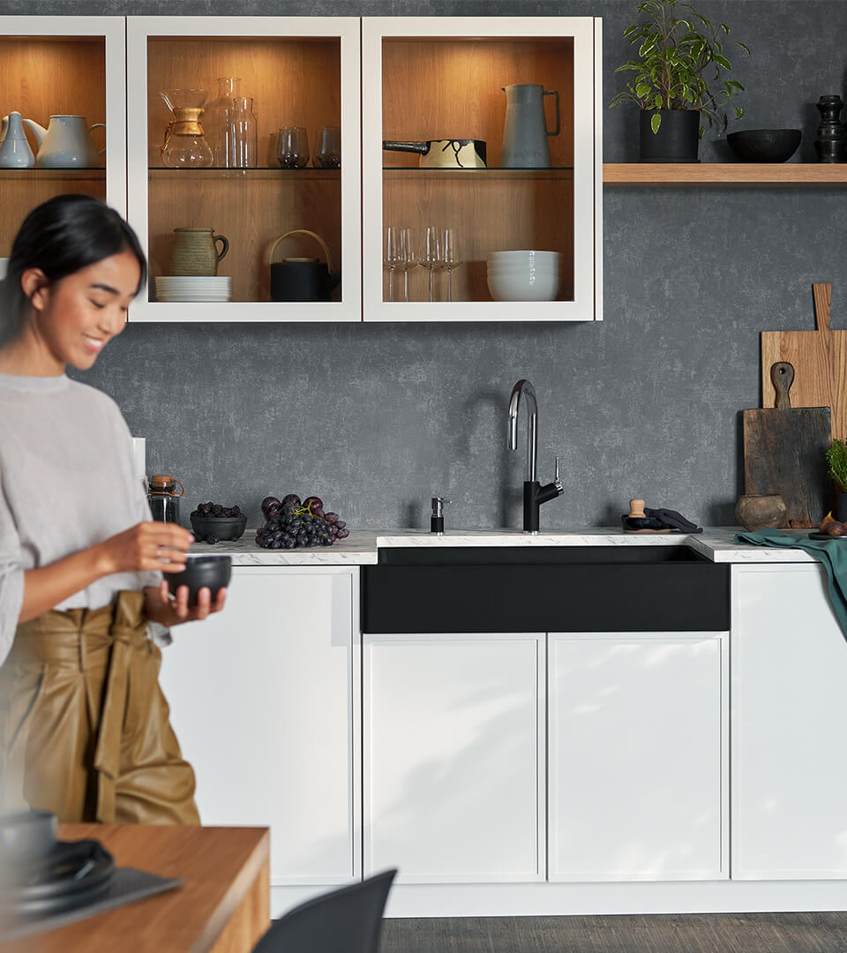
Company presentation

Slide 2
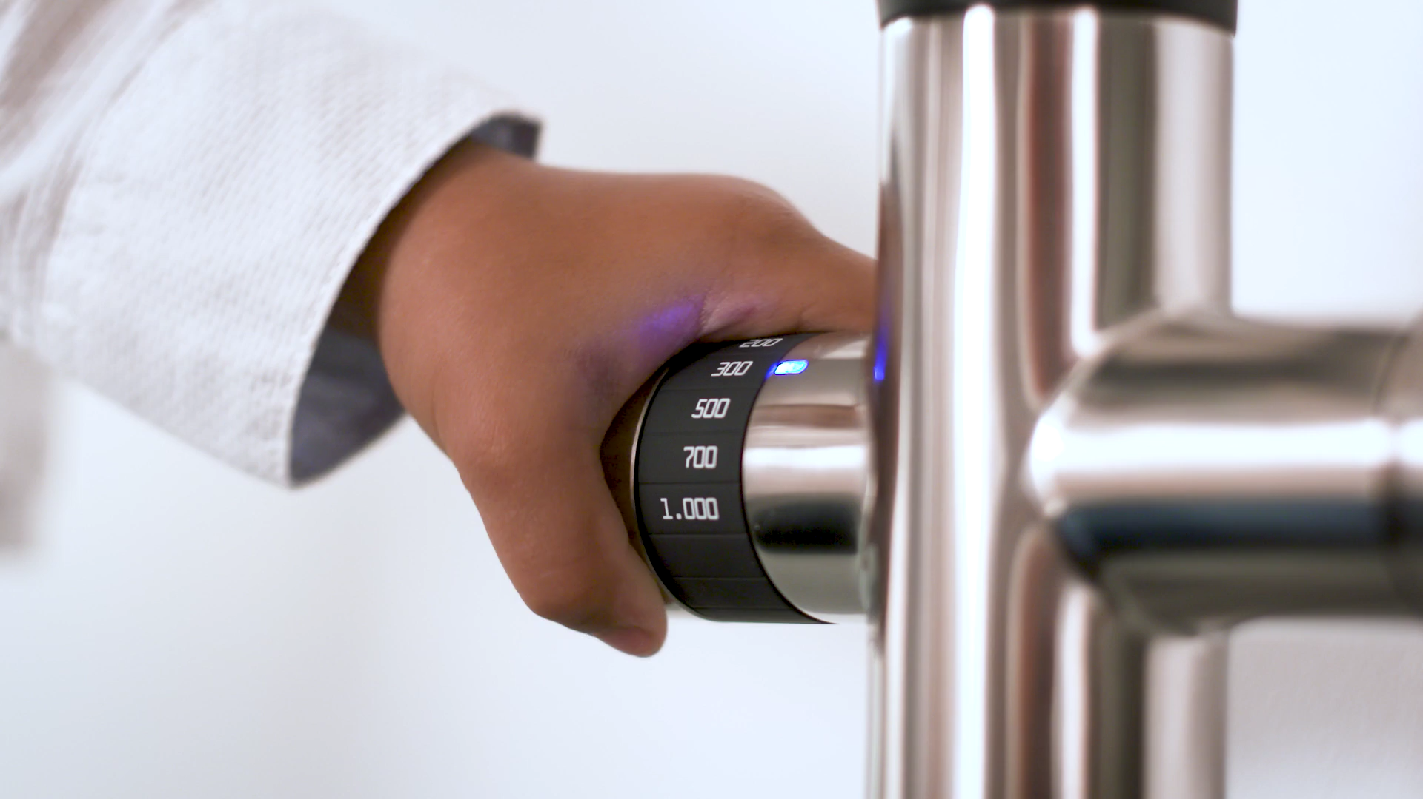
The kitchen is the heart of our home
It is where we live, laugh, learn and experiment.
We believe creating the perfect water place makes a vital contribution to our quality of life.

Slide 3
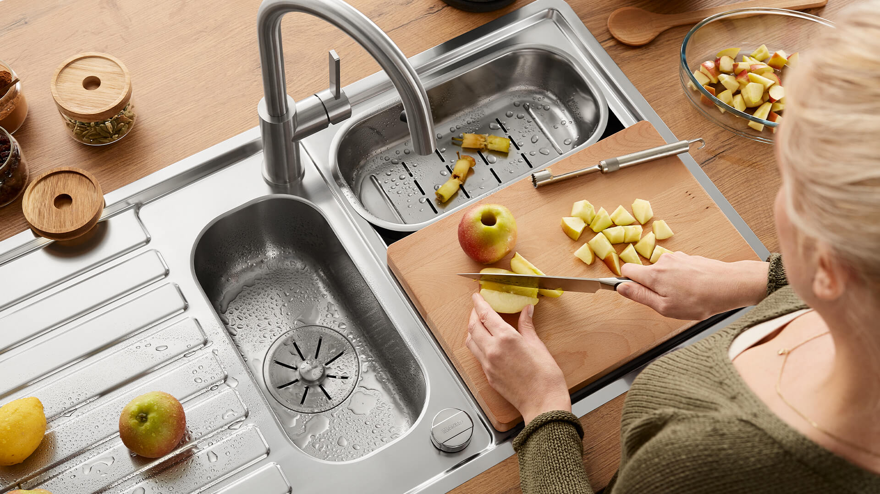
Time is precious
Our work focuses on the needs of those who use our products
every day. We develop products and solutions to make daily tasks
in the kitchen easier and more enjoyable.

Slide 4
A seamless solution for the water place
drink. prep. clean. With more than 500,000 possible combinations, the BLANCO UNIT offers individual solutions for the three central themes in everyday kitchen life.
Drink
The UNIT supplies either boiling hot, chilled, still or carbonated water. Pre-filtered straight from the tap.
Prepare
Wash, peel, chop: The tidy design of the UNIT provides a perfect spot to perform any task, thus keeping the water place neat.
Clean
With its clever unit comprising a highly functional tap, spacious sink and worktop, the UNIT makes cleaning dishes child's play.
Sort and dispose
The UNIT offers various solutions for sorting and disposing of kitchen waste. The ingenious system saves space and unnecessary walking distances.

Slide 5
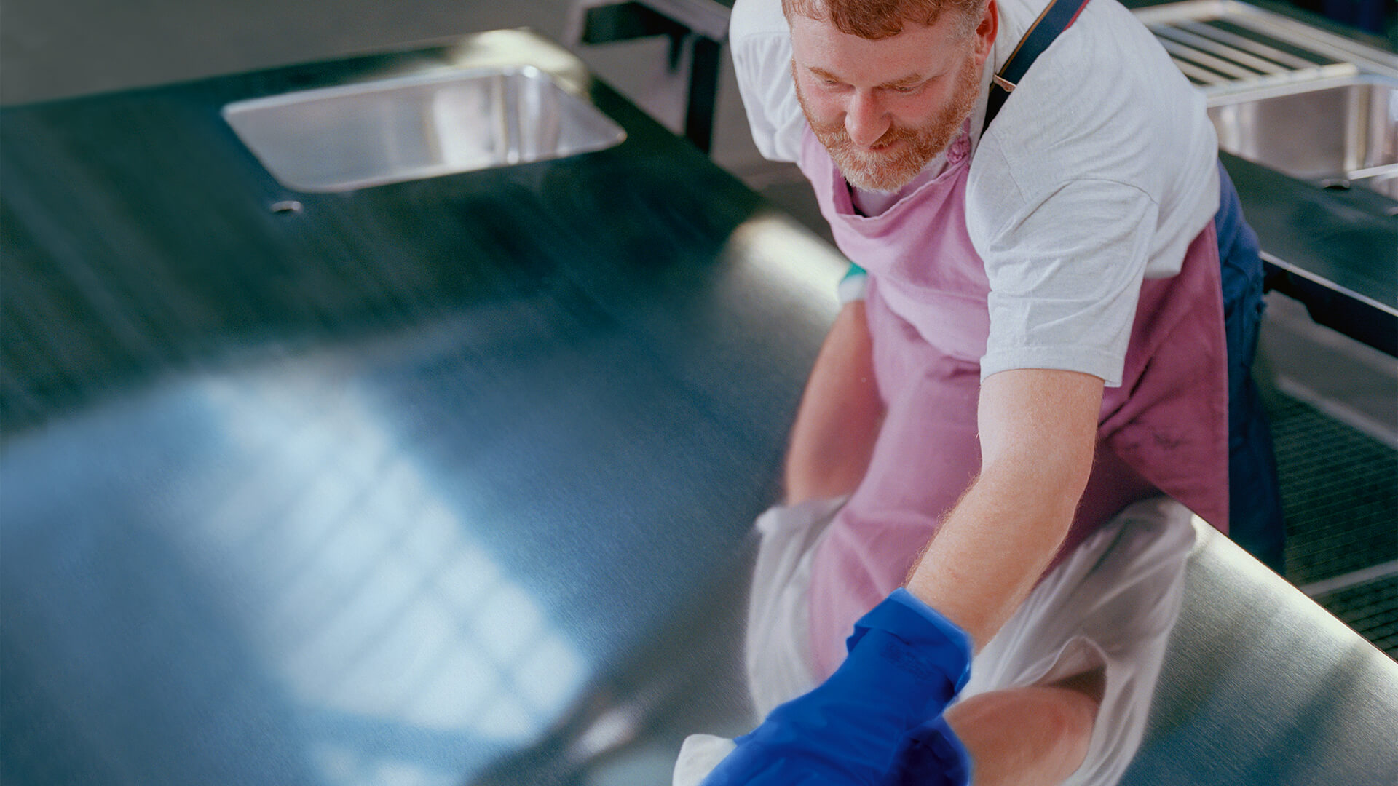
BLANCO figures 2020
408
1.542
million euro in sales
employees
18,4
63%
million euro in investments
share of sales international

Slide 6
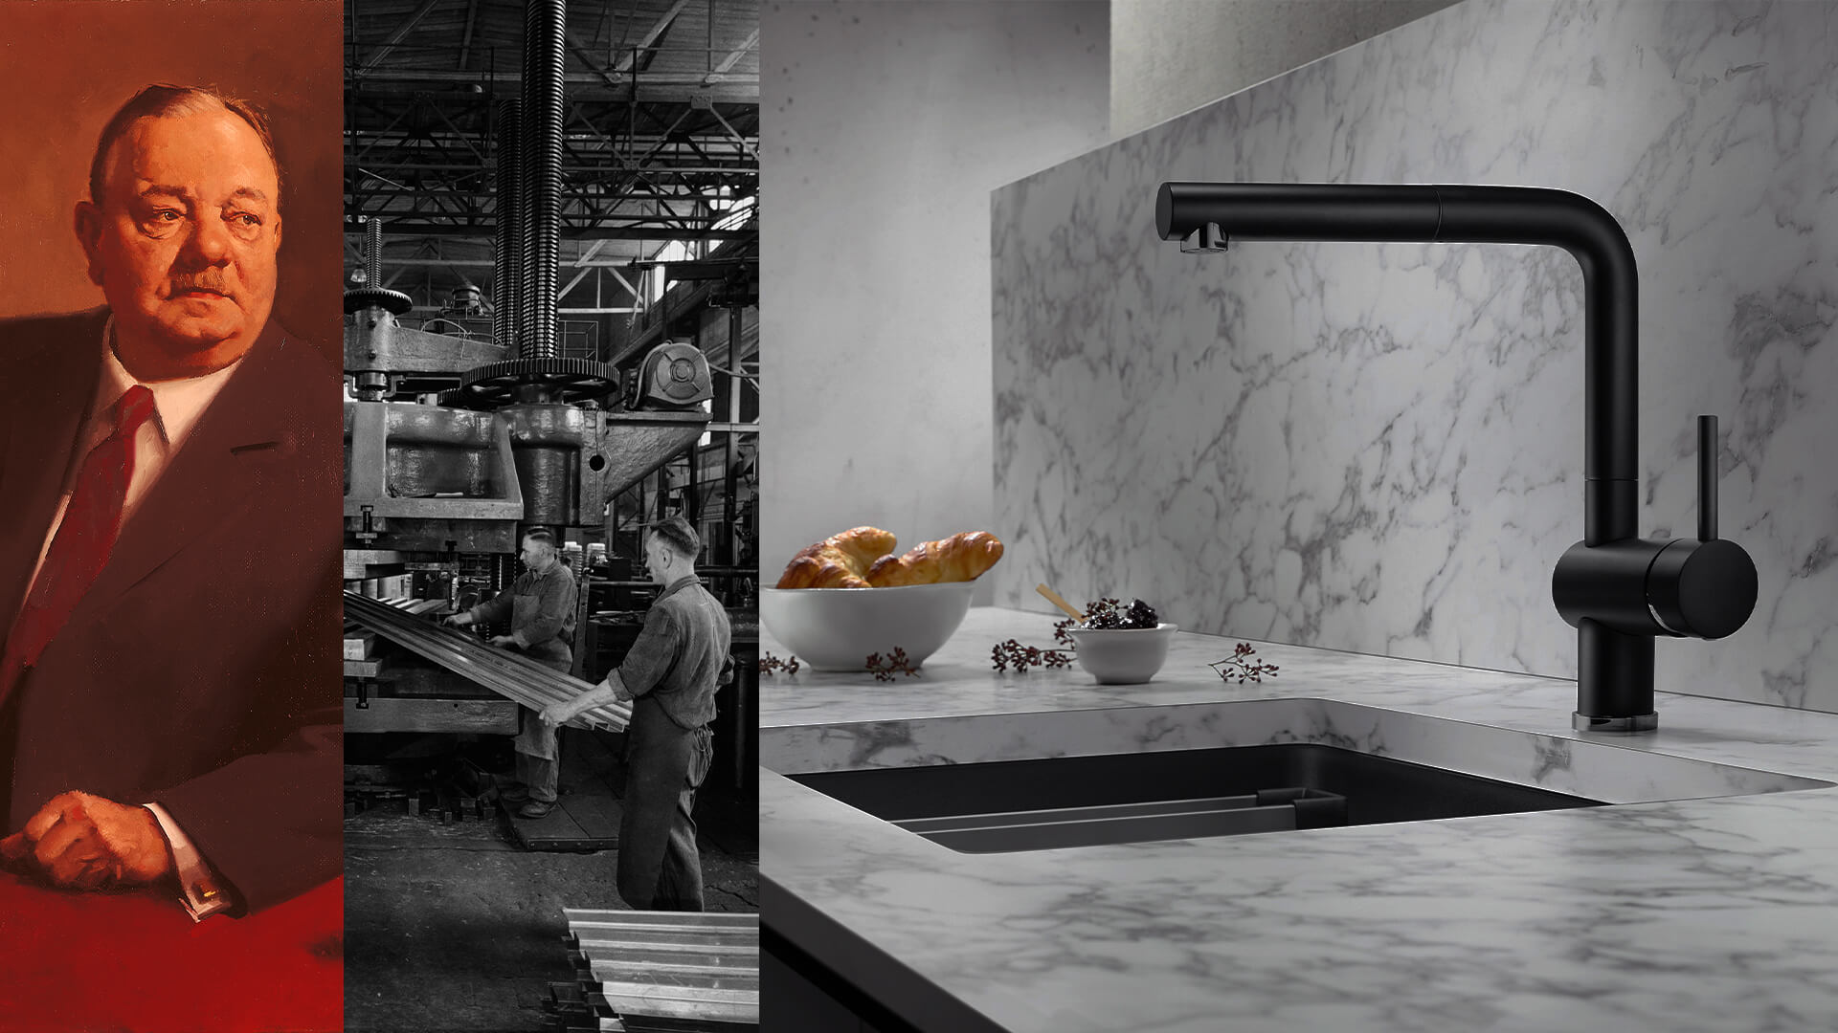
Passion for kitchen sinks since 1925
At BLANCO we are passionate about kitchens and have been developing new ideas for making water places even better, more beautiful and more innovative for over 95 years now.

Slide 7
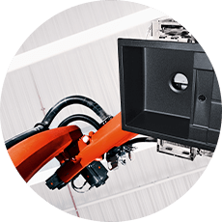
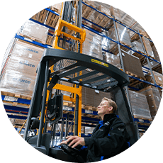

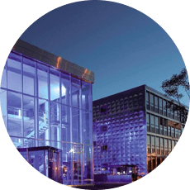
Passion for the product and the region
Sinsheim
Silgranit sinks
As a family-owned company with a strong connection to its home region, BLANCO has emphasised sustainability and respect from day one.
Bruchsal
European logistics centre
Sulzfeld
Stainless steel sinks
Oberderdingen
Headquarters
Passion

Slide 8
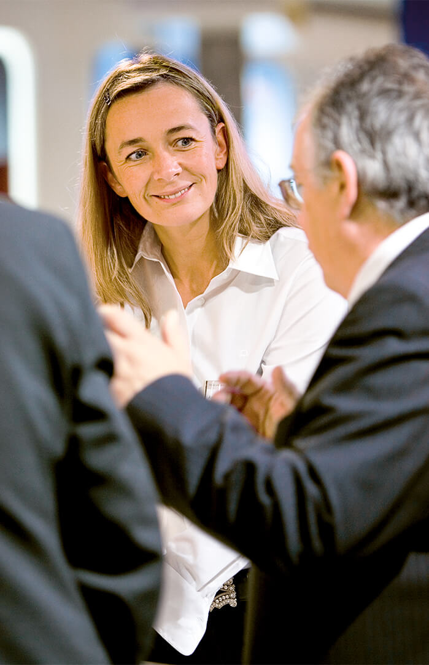
We are on a growth trajectory
394
395
408
361
379
million euro in sales

Slide 9
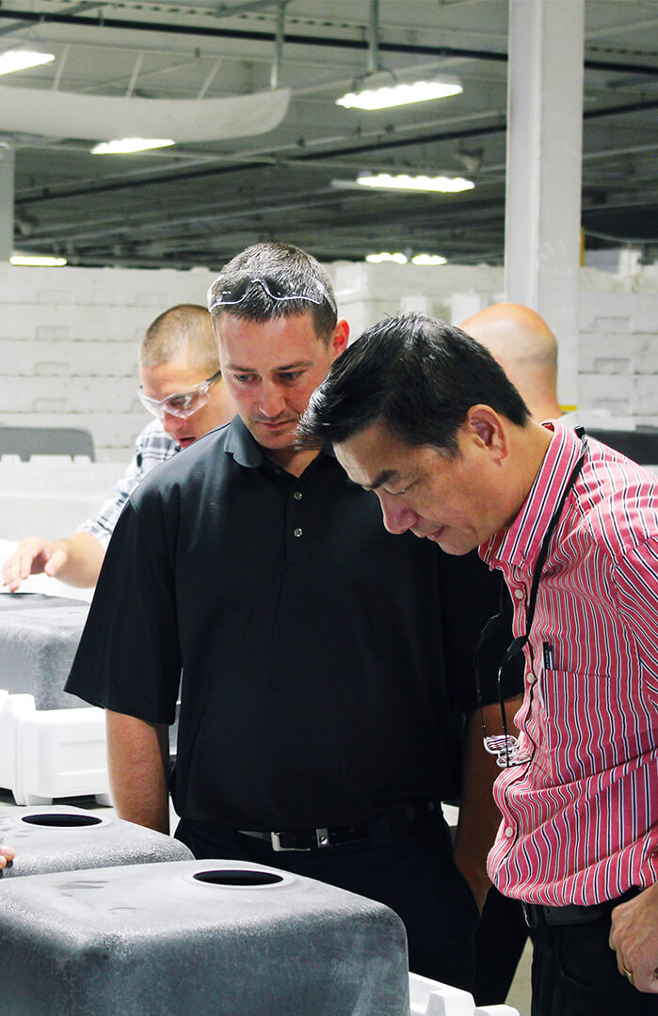
Investments in international growth
29,3
18,9
18,4
16,2
17,2
million euro in investments

Slide 10

Global growth
BLANCO is advancing sustainable expansion of its brand with a focus on three global regions.
North America
3 locations
EMEA
12 locations
APAC
3 locations

Slide 11
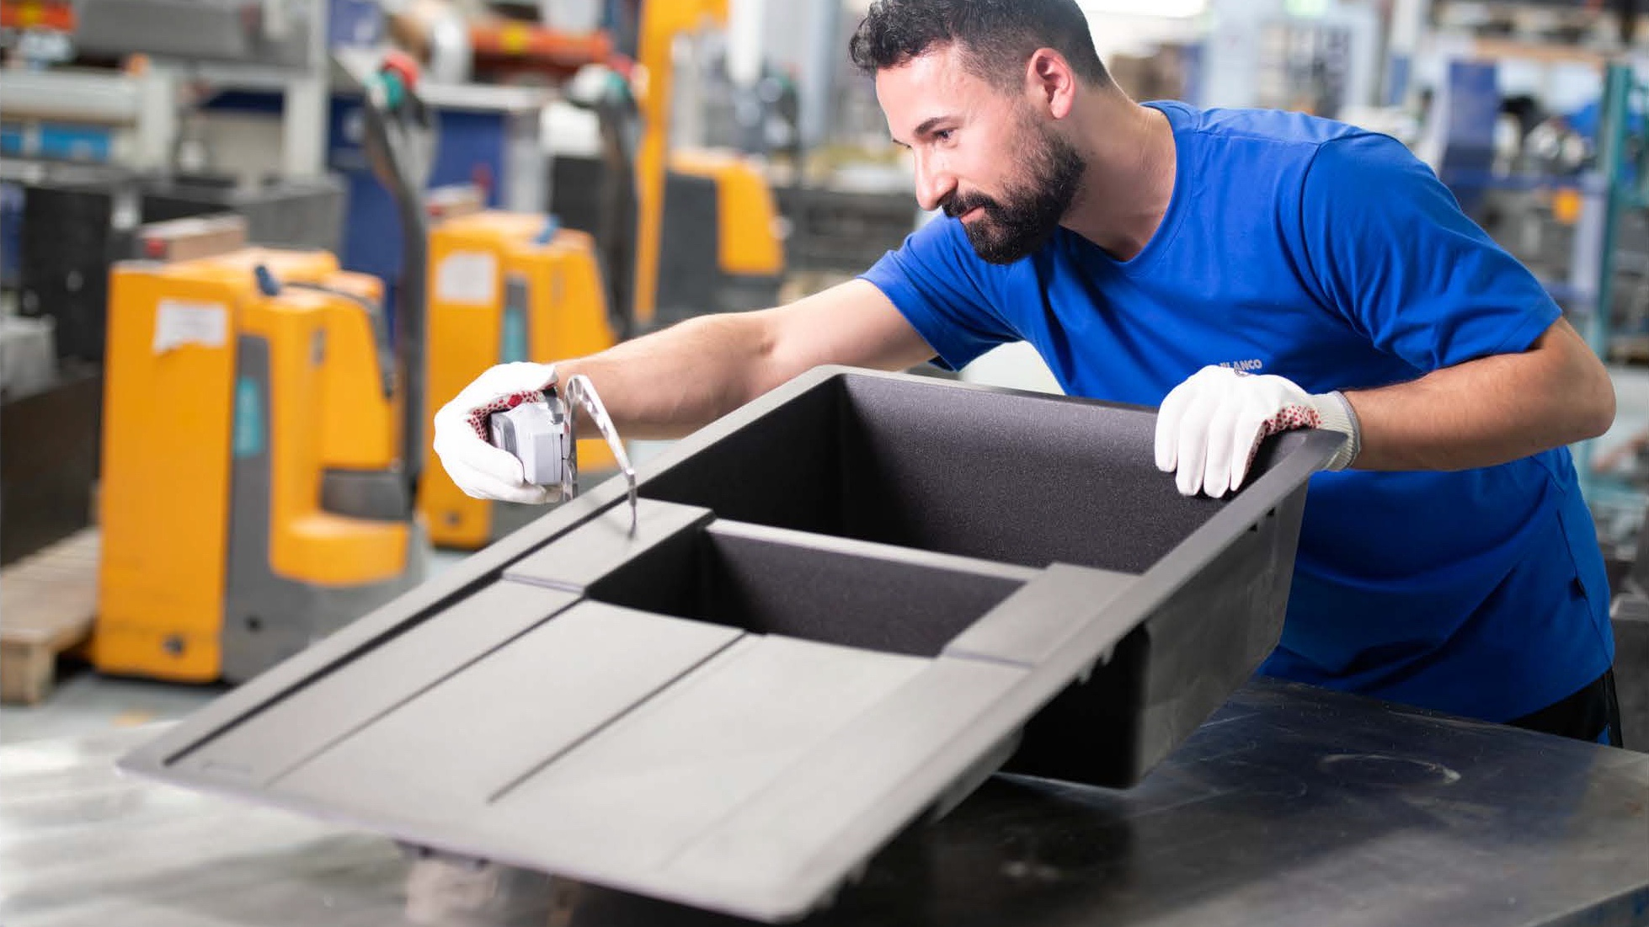
Production: Toronto · Most (CZ)
Sustainable international
growth
To ensure an optimal supply chain, we manufacture our Silgranit sinks at selected international locations.

Slide 12
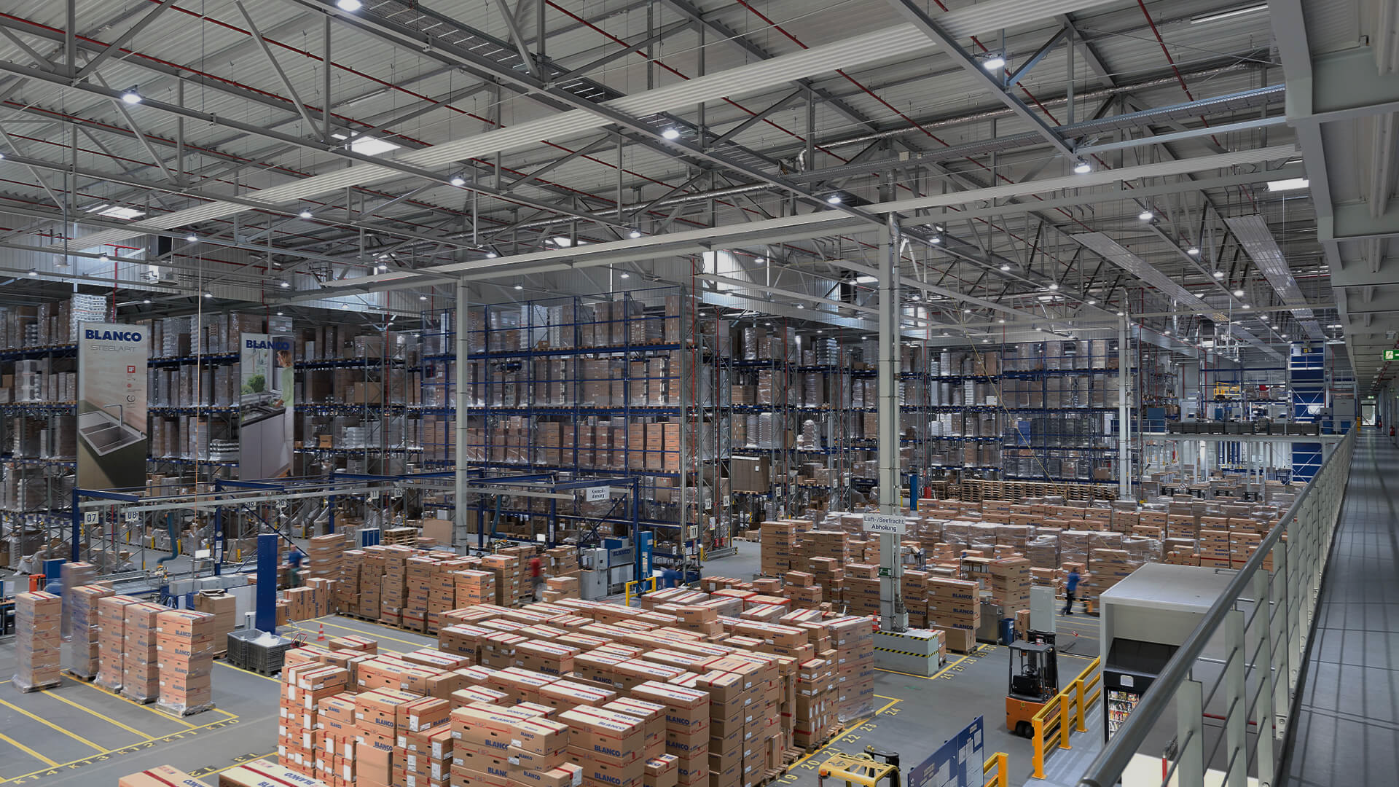
Logistics: Toronto · Bruchsal · Moscow · Shanghai · St. Albans/UK · Lumberton/USA
Sustainable international
growth
Over the past few years, we have developed a highly efficient logistics network comprising six locations on three continents.

Slide 13
Triple P: Our sustainability strategy
Performance, Planet and People: These three sustainability dimensions are integrated in the corporate strategy as part of our daily business and a global project set up specifically for this purpose.
Performance
Planet
People
Targeting economic growth with a sustainable and long-term increase in profitability, viability and liquidity, while also strengthening resilience.
Saving energy, reducing CO2 emissions, protecting resources, providing sustainable products and services, and achieving accountability in the supply chain.
Raising sustainability awareness through training and further development, while also promoting diversity and flexible working models along with occupational safety and health.

Slide 14




BLANCO within the
BLANC & FISCHER Family Holding

Slide 15
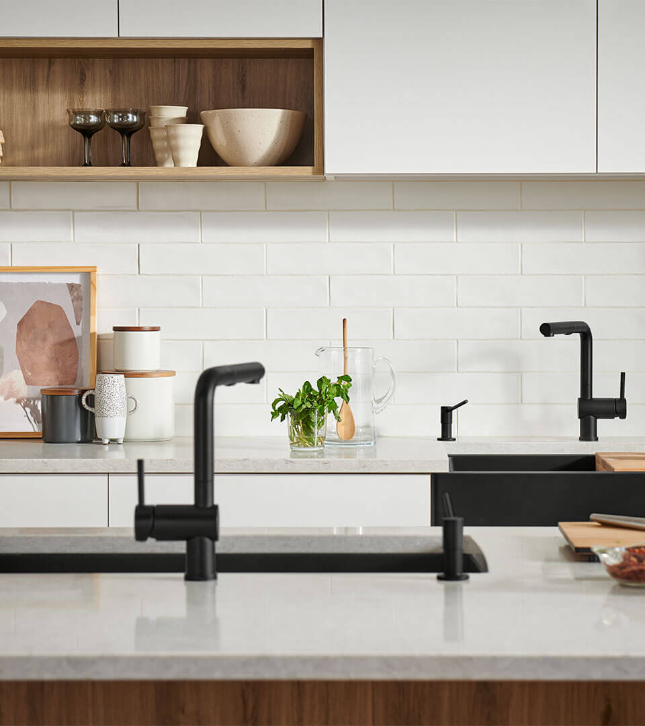
Antje Hilbert
BLANCO Corporate Communications
Phone: +49 7045 44-81404
antje.hilbert@blanco.de
blanco.com

